Slide 1
Evaluating Least Squares Channel Estimation for Massive-MIMO OFDM
Alexander Fernandes, 260960205, alexander.fernandes@mail.mcgill.ca

Slide 2
Outline:
Introduction
Outline
Motivation
Objectives
Scopes
Massive-MIMO Correlation-Based Stochastic Models
Massive-MIMO-OFDM Channel Estimation
Massive-MIMO Linear Detection
Conclusion

Slide 3
Motivation:
Massive-Multiple-Input-Multiple-Output
Larger amount of MIMO than traditional 2x2 or 4x4
Improve reliability of signal connection and provide faster rates by spatially combining the signal with more transmitter and receiver antennas [2].
Channel hardening helps reduce statistical fluctuations in fading channels [3].
Orthogonal Frequency Division Multiplexing
Spectral efficiency from overlap in frequency spectrum over multiple channels [2].
Partition bandwidth into frequency bands for flat-fading subchannels
Correlation Based Stochastic Models
Theoretical channel models used to evaluate performance of Massive-MIMO [5]
Examples, Rayleigh, Rician, Correlation [5]
Massive-MIMO-OFDM issues
Obtain Channel State Information (CSI) with large number of antennas
Signal detection in Massive-MIMO system

Slide 4
Objectives:
Evaluate a Massive-MIMO-OFDM system
Replicate and extend the work of Riadi et al [7]
Riadi et al [7] work:
Least Squares Channel Estimation of Massive-MIMO (50x50) & (50x300)
Detection Schemes: ZF & MMSE
16/64/128-QAM, and 64/256/1024 OFDM subcarriers
My project
Least Squares Channel Estimation of Massive-MIMO (50x50/100/200/300)
Detection Schemes: MF, ZF, MMSE
16/64/128-QAM, and 64/256/1024 OFDM subcarriers
CBSC: Rayleigh, Rician and Correlation Channel Models

Slide 5
Scopes:
Massive-MIMO Correlation-Based Stochastic Models
Review how Rayleigh, Rician and Correlation Channel models are generated in Massive-MIMO Multipath channels
Generate channel models and compare amplitude matrix and power delay profile
MIMO-OFDM Channel Estimation
Describe the Massive-MIMO-OFDM channel model for uplink transmission
Show how LSCE is trained using OFDM pilot uplink transmission
Measure the MSE vs SNR of LSCE for each generated channel: Rayleigh, Rician and Correlation
Massive-MIMO Linear Detection
Survey Linear Detection schemes: Matched Filter, Zero Forcing and Minimum Mean Square Error and how they are performed in MIMO
Evaluate BER vs SNR the MF, ZF and MMSE schemes for LSCE for each generated channel: Rayleigh, Rician and Correlation

Slide 6
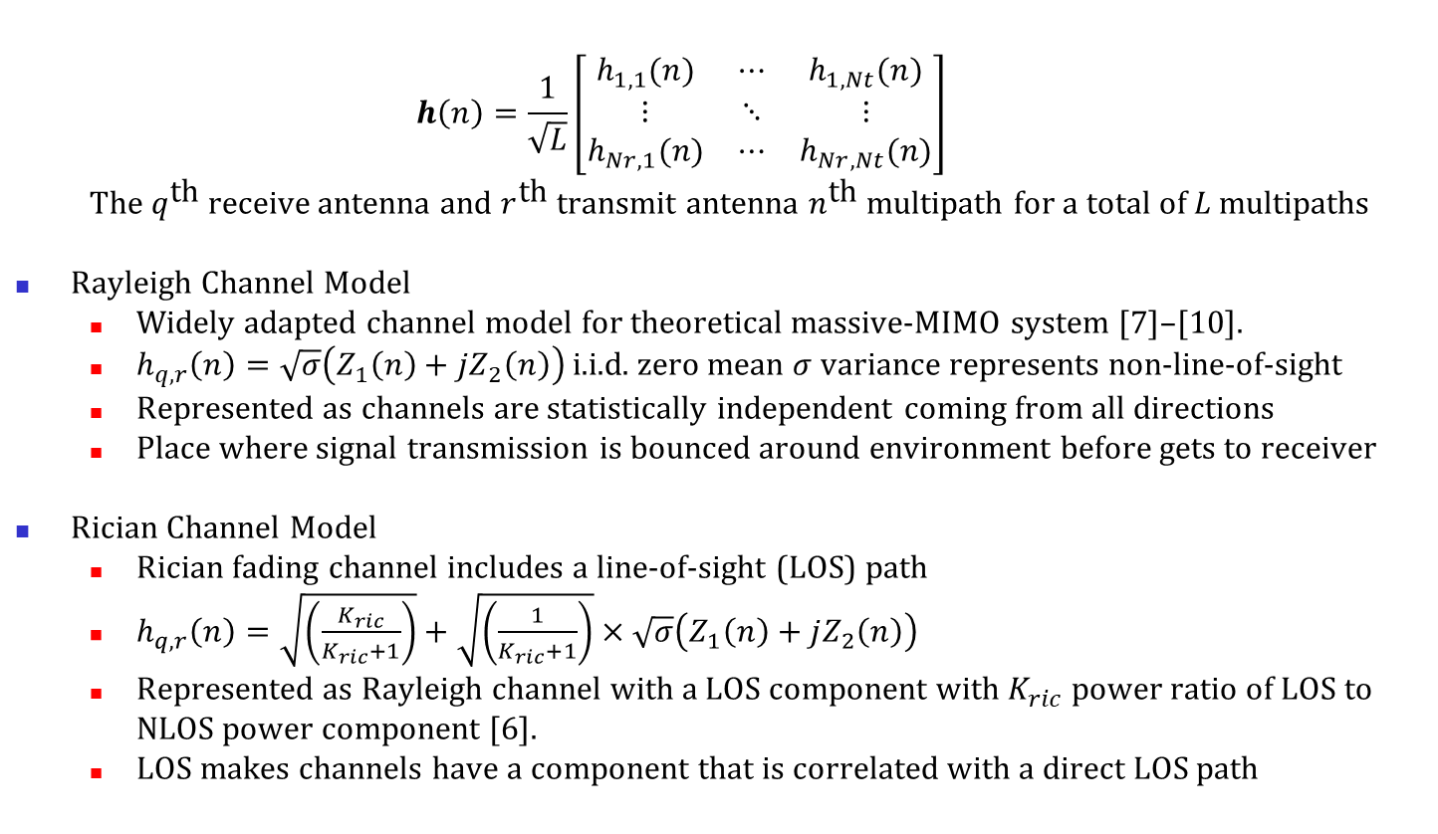
Massive-MIMO Correlation Based Stochastic Models
$$h\left(n\right)=\frac{1}{\sqrt{L}}\left[\begin{matrix}h_{1,1}(n) & ⋯ & h_{1,Nt}(n) \\ ⋮ & ⋱ & ⋮ \\ h_{Nr,1}(n) & ⋯ & h_{Nr,Nt}(n)\end{matrix}\right]$$
The $q^{\text{th}}$ receive antenna and $r^{\text{th}}$ transmit antenna $n^{\text{th}}$ multipath for a total of $L$ multipaths
Rayleigh Channel Model
Widely adapted channel model for theoretical massive-MIMO system [7]–[10].
$h_{q,r}\left(n\right)=\sqrt{σ}\left(Z_{1}\left(n\right)+jZ_{2}\left(n\right)\right)$ i.i.d. zero mean $σ$ variance represents non-line-of-sight
Represented as channels are statistically independent coming from all directions
Place where signal transmission is bounced around environment before gets to receiver
Rician Channel Model
Rician fading channel includes a line-of-sight (LOS) path
$h_{q,r}\left(n\right)=\sqrt{\left(\frac{K_{ric}}{K_{ric}+1}\right)}+\sqrt{\left(\frac{1}{K_{ric}+1}\right)}×\sqrt{σ}\left(Z_{1}\left(n\right)+jZ_{2}\left(n\right)\right)$
Represented as Rayleigh channel with a LOS component with $K_{ric}$ power ratio of LOS to NLOS power component [6].
LOS makes channels have a component that is correlated with a direct LOS path

Slide 7
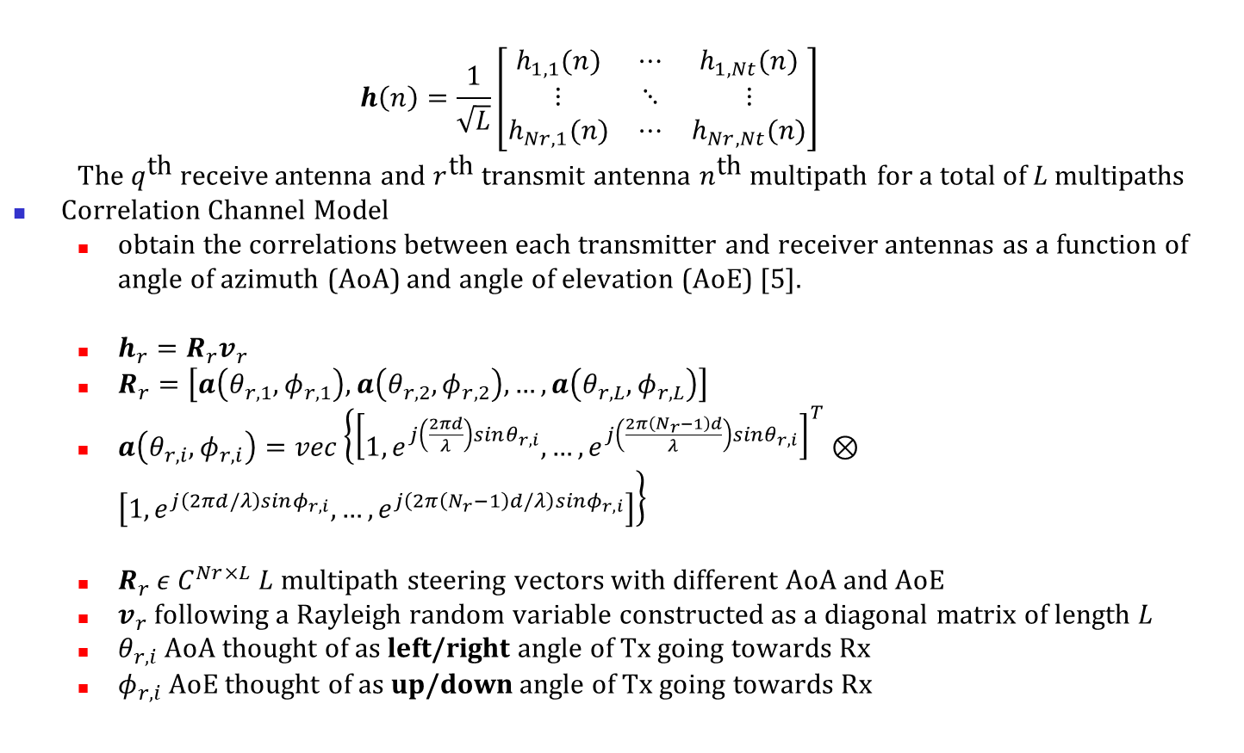
Massive-MIMO Correlation Based Stochastic Models
$$h\left(n\right)=\frac{1}{\sqrt{L}}\left[\begin{matrix}h_{1,1}(n) & ⋯ & h_{1,Nt}(n) \\ ⋮ & ⋱ & ⋮ \\ h_{Nr,1}(n) & ⋯ & h_{Nr,Nt}(n)\end{matrix}\right]$$
The $q^{\text{th}}$ receive antenna and $r^{\text{th}}$ transmit antenna $n^{\text{th}}$ multipath for a total of $L$ multipaths
Correlation Channel Model
obtain the correlations between each transmitter and receiver antennas as a function of angle of azimuth (AoA) and angle of elevation (AoE) [5].
$h_{r}=R_{r}v_{r}$
$R_{r}=\left[a\left(θ_{r,1},φ_{r,1}\right),a\left(θ_{r,2},φ_{r,2}\right),…,a\left(θ_{r,L},φ_{r,L}\right)\right]$
$a\left(θ_{r,i},φ_{r,i}\right)=vec\left\{{\left[1, e^{j\left(\frac{2πd}{λ}\right)sinθ_{r,i}},…,e^{j\left(\frac{2π\left(N_{r}−1\right)d}{λ}\right)sinθ_{r,i}}\right]}^{T}⊗\left[1, e^{j\left(2πd/λ\right)sinφ_{r,i}},…,e^{j\left(2π\left(N_{r}−1\right)d/λ\right)sinφ_{r,i}}\right]\right\}$
$R_{r} ε C^{Nr×L}$ $L$ multipath steering vectors with different AoA and AoE
$v_{r}$ following a Rayleigh random variable constructed as a diagonal matrix of length $L$
$θ_{r,i}$ AoA thought of as left/right angle of Tx going towards Rx
$φ_{r,i}$ AoE thought of as up/down angle of Tx going towards Rx

Slide 8
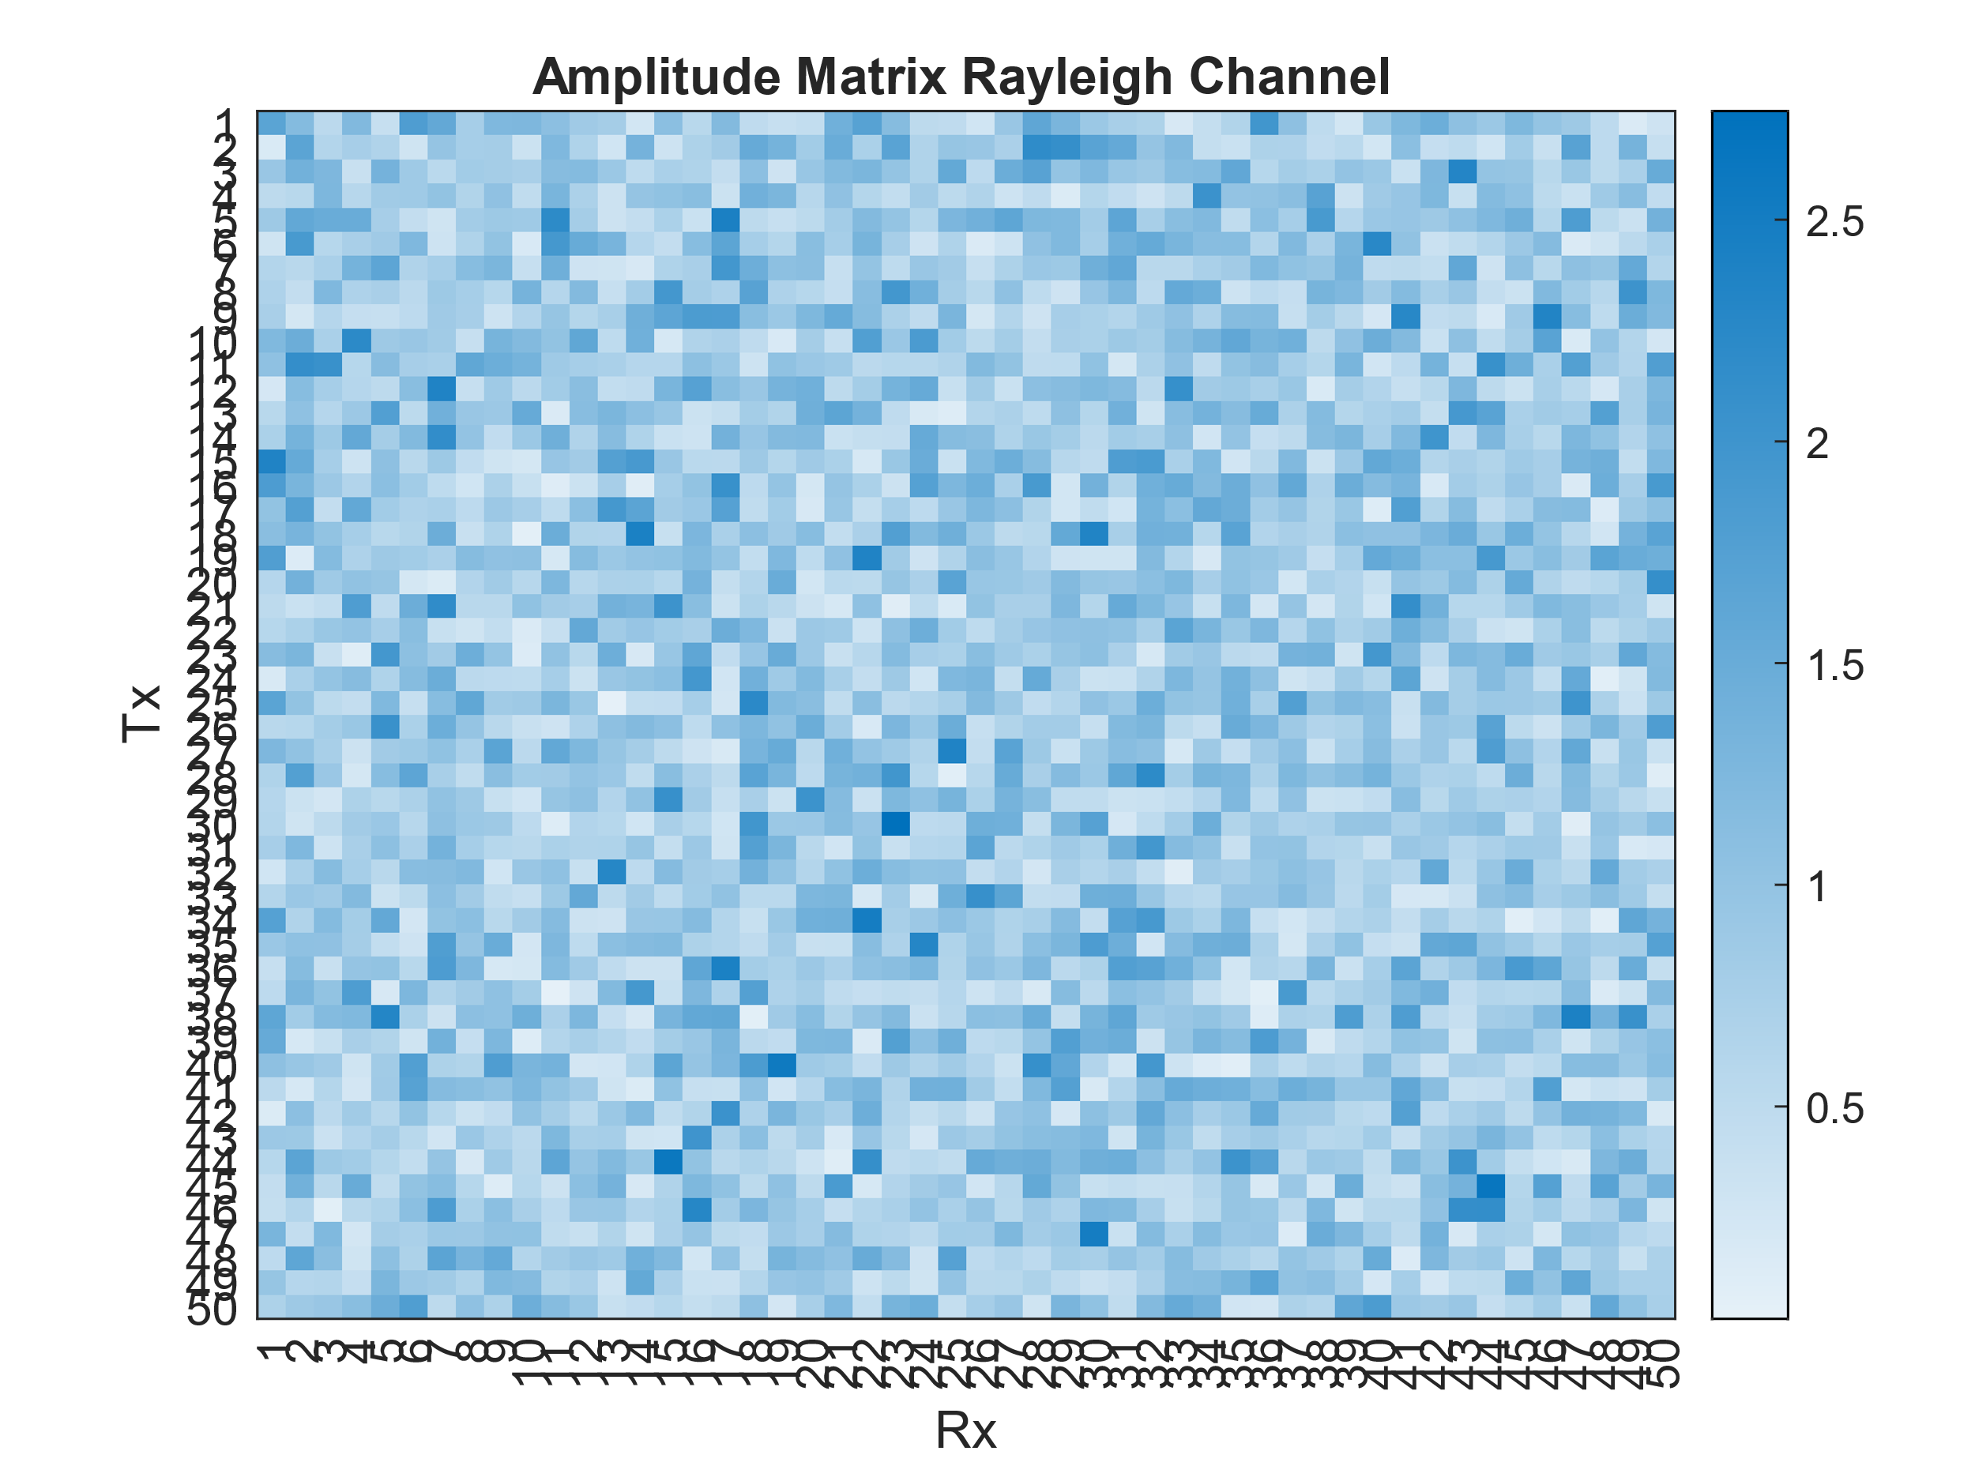
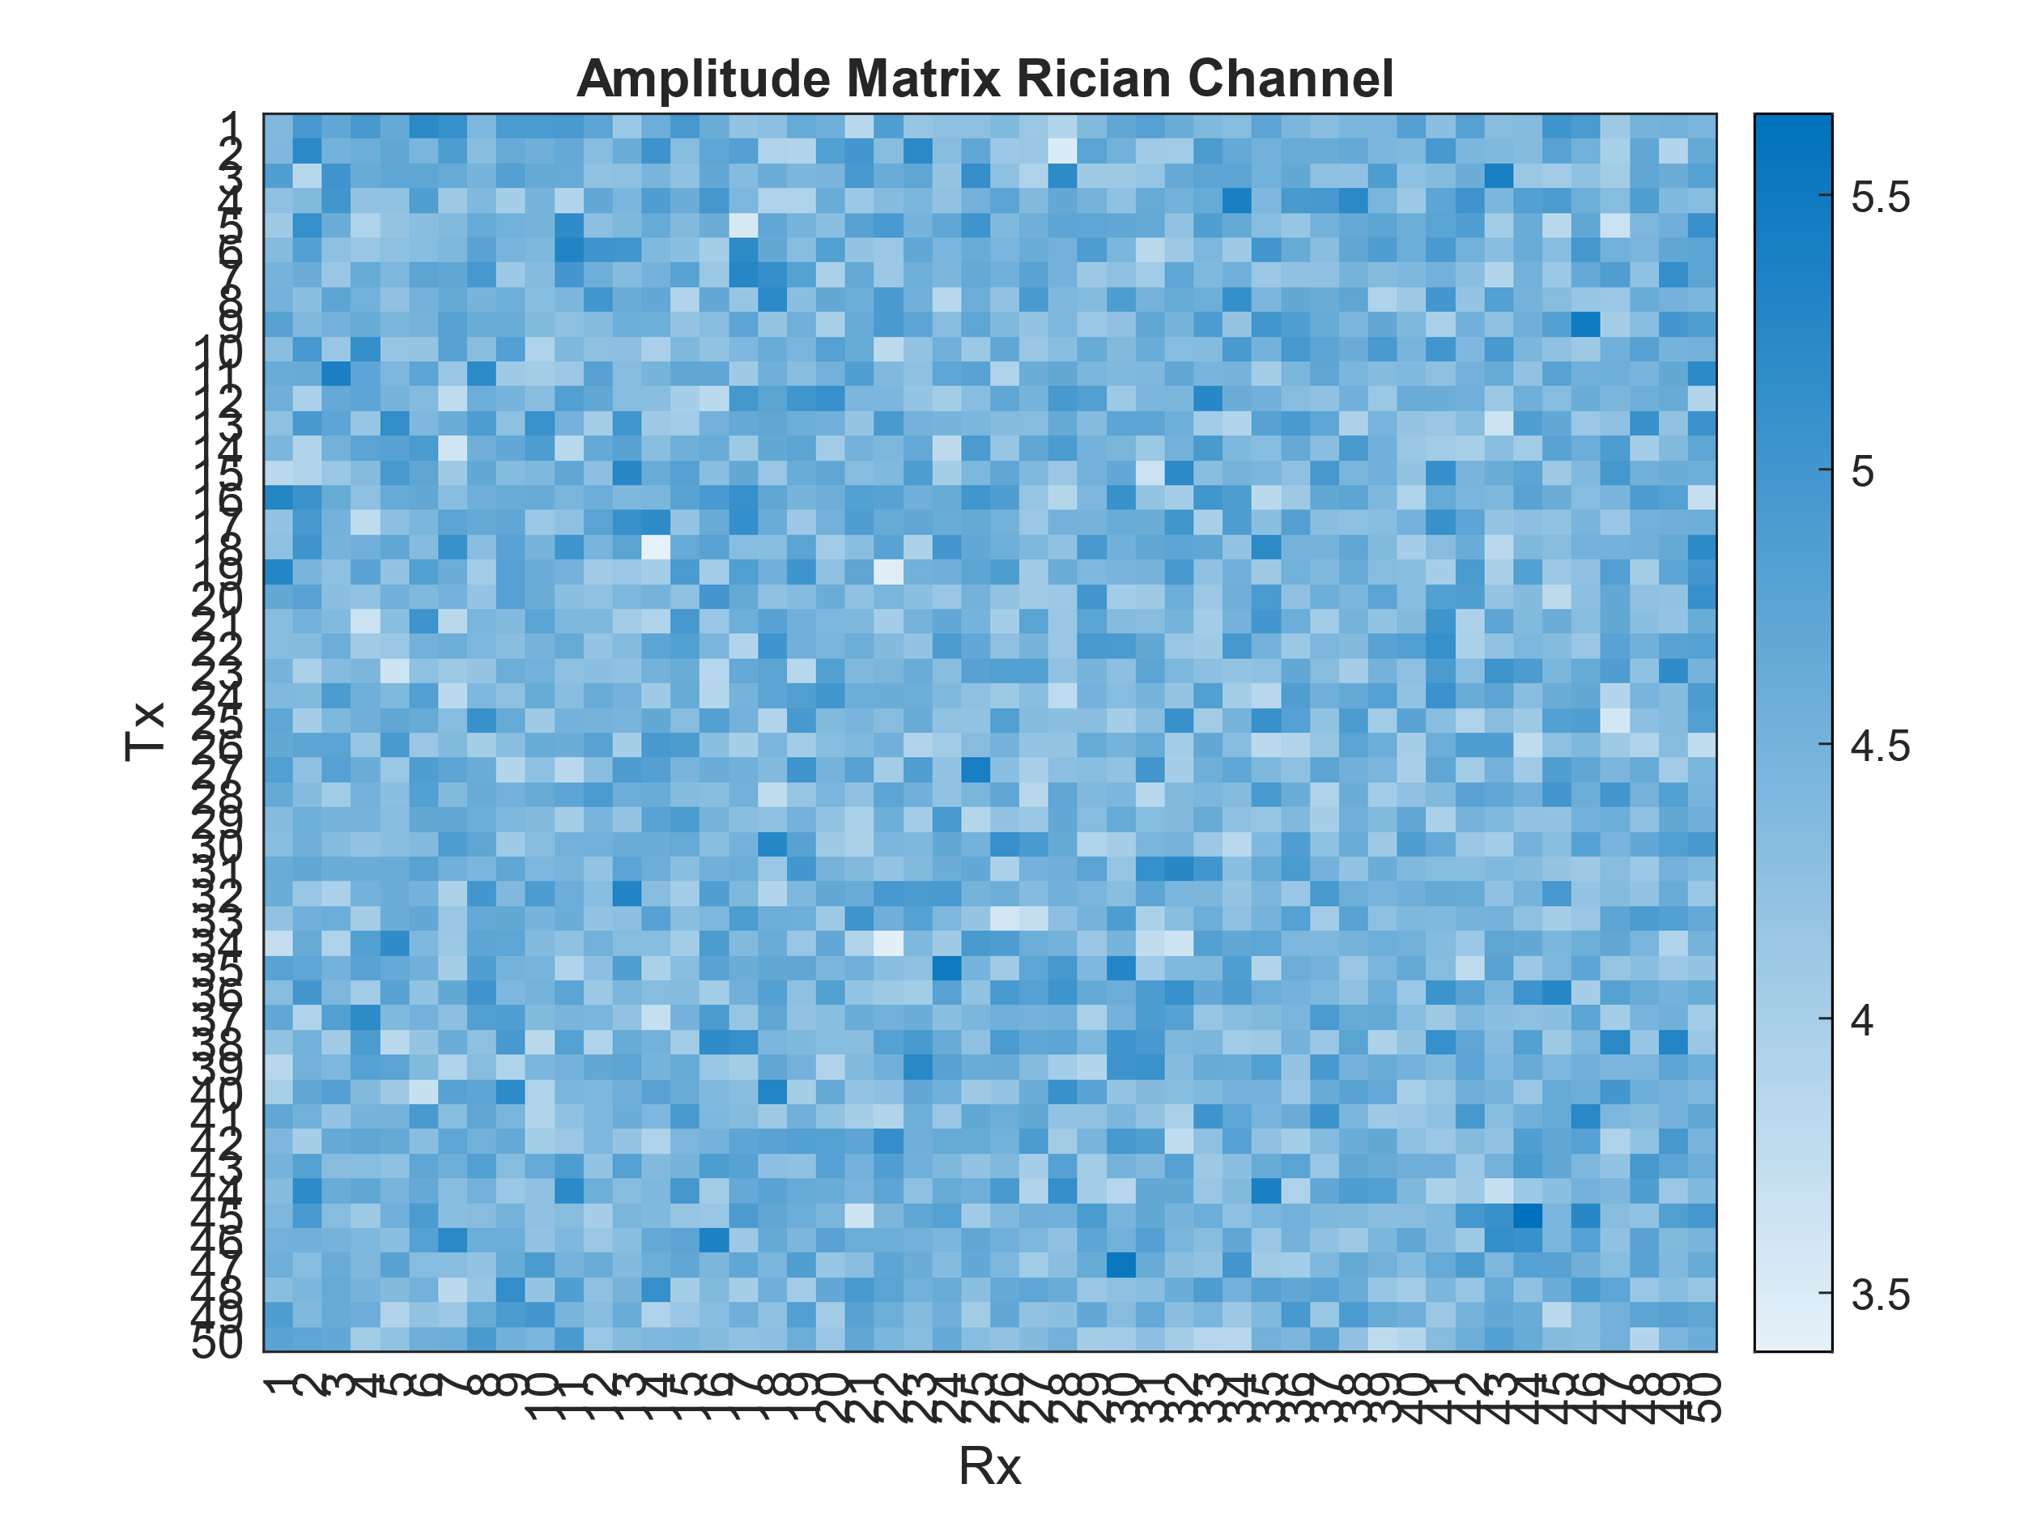
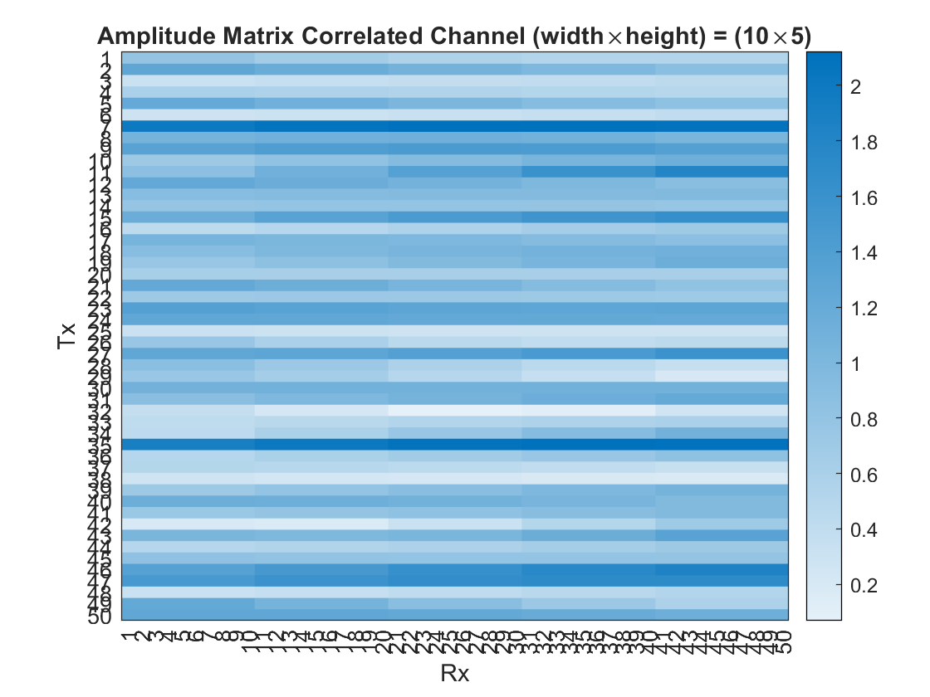
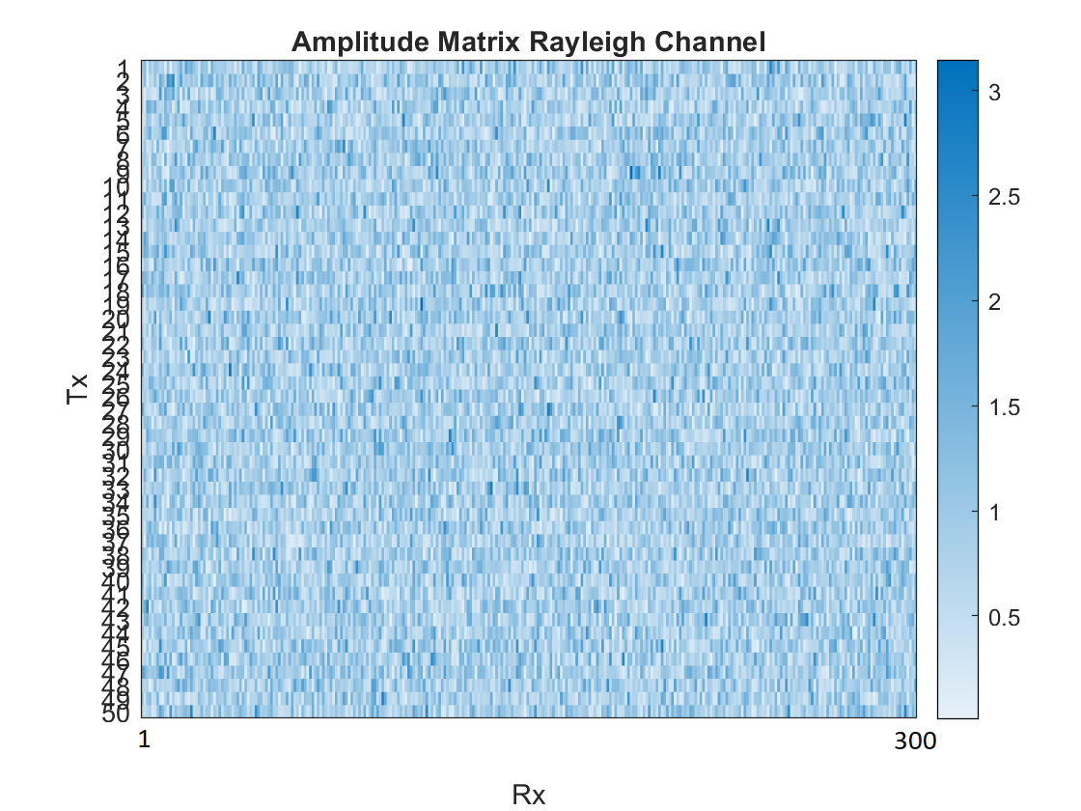
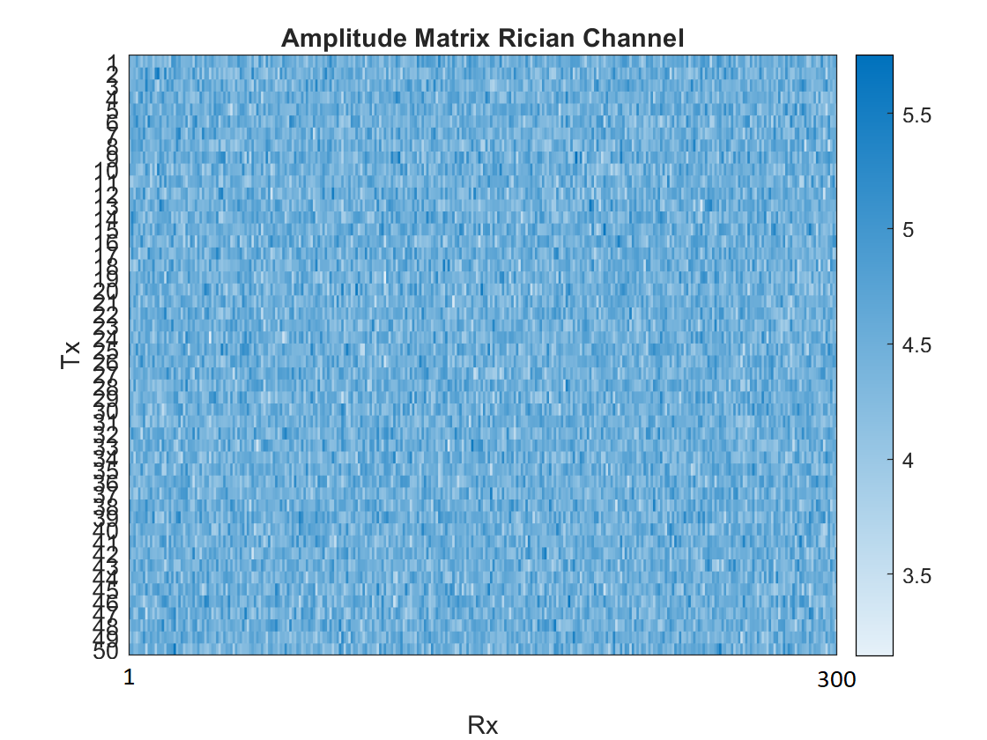
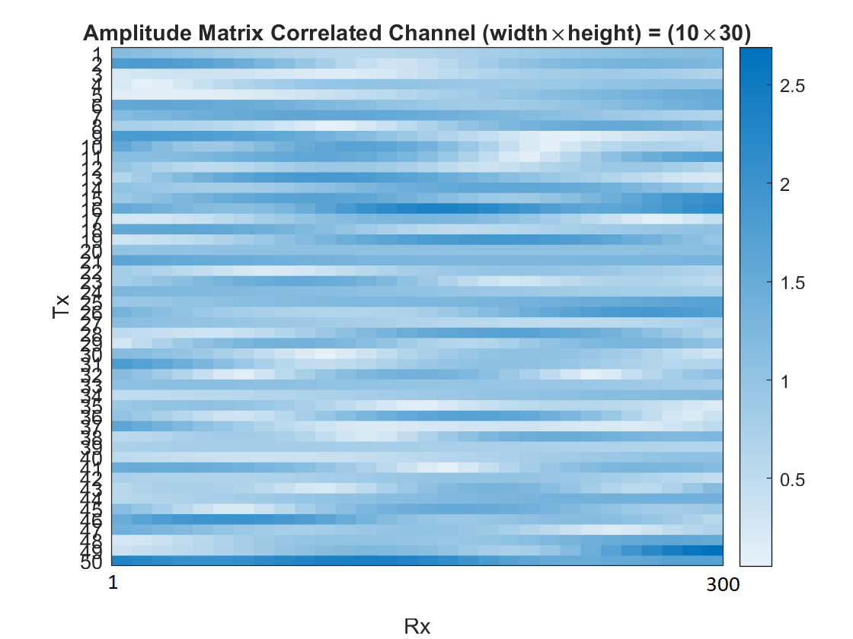
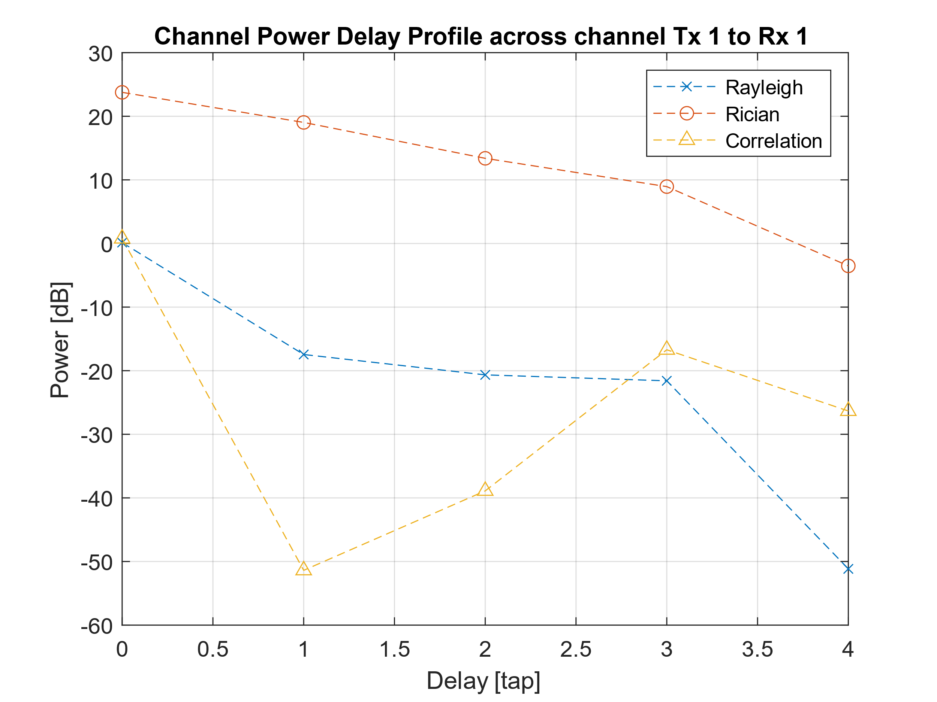
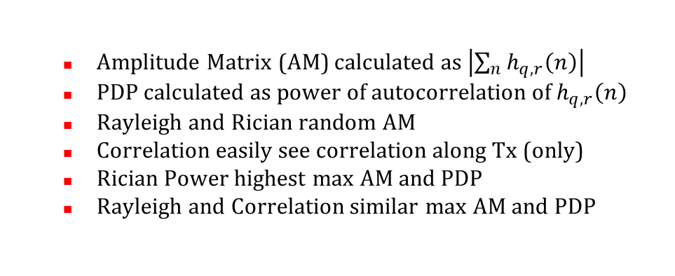
Massive-MIMO Correlation Based Stochastic Models
Amplitude Matrix (AM) calculated as $\left|\sum_{n}{h_{q,r}\left(n\right)}\right|$
PDP calculated as power of autocorrelation of $h_{q,r}\left(n\right)$
Rayleigh and Rician random AM
Correlation easily see correlation along Tx (only)
Rician Power highest max AM and PDP
Rayleigh and Correlation similar max AM and PDP

Slide 9
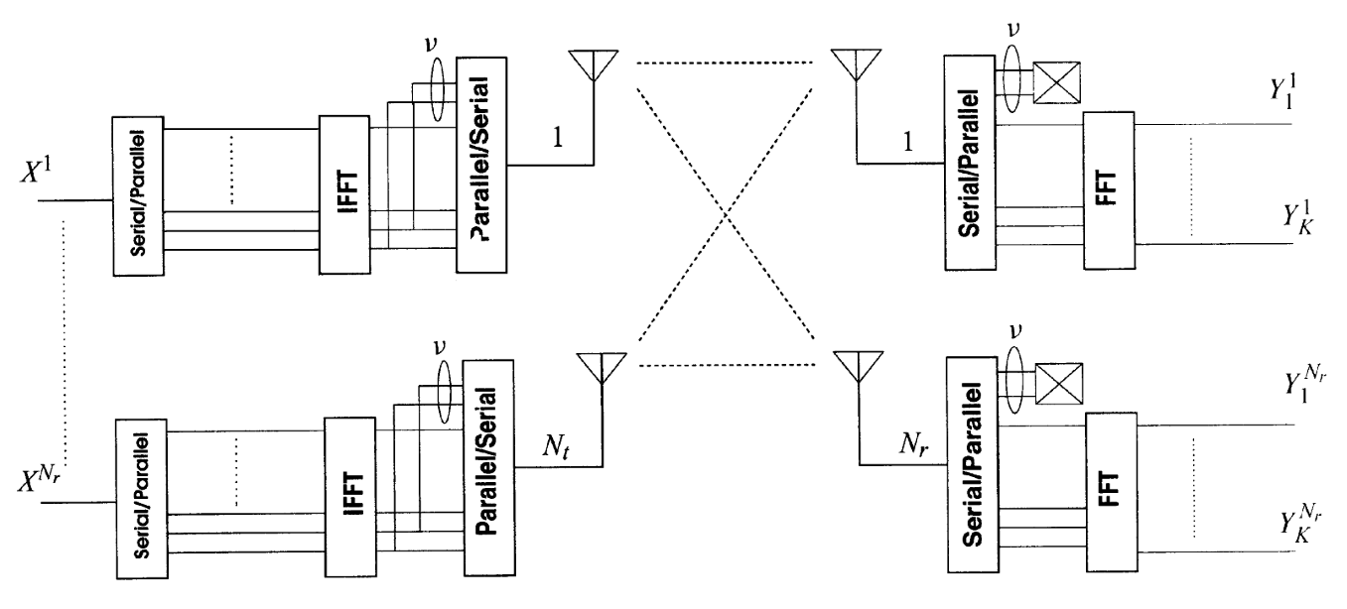
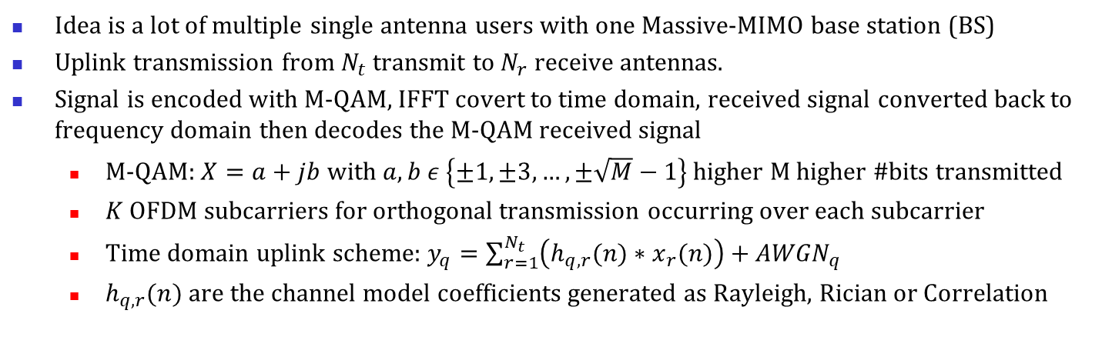
Massive-MIMO-OFDM Channel Estimation
Figure obtained from Fig. 1 of I. Barhumi et al [14].
Idea is a lot of multiple single antenna users with one Massive-MIMO base station (BS)
Uplink transmission from $N_{t}$ transmit to $N_{r}$ receive antennas.
Signal is encoded with M-QAM, IFFT covert to time domain, received signal converted back to frequency domain then decodes the M-QAM received signal
M-QAM: $X=a+jb$ with $a,b ε \left\{±1,±3,…,±\sqrt{M}−1\right\}$ higher M higher #bits transmitted
$K$ OFDM subcarriers for orthogonal transmission occurring over each subcarrier
Time domain uplink scheme: $y_{q}=\sum_{r=1}^{N_{t}}{\left(h_{q,r}(n)∗x_{r}(n)\right)}+{AWGN}_{q}$
$h_{q,r}(n)$ are the channel model coefficients generated as Rayleigh, Rician or Correlation

Slide 10
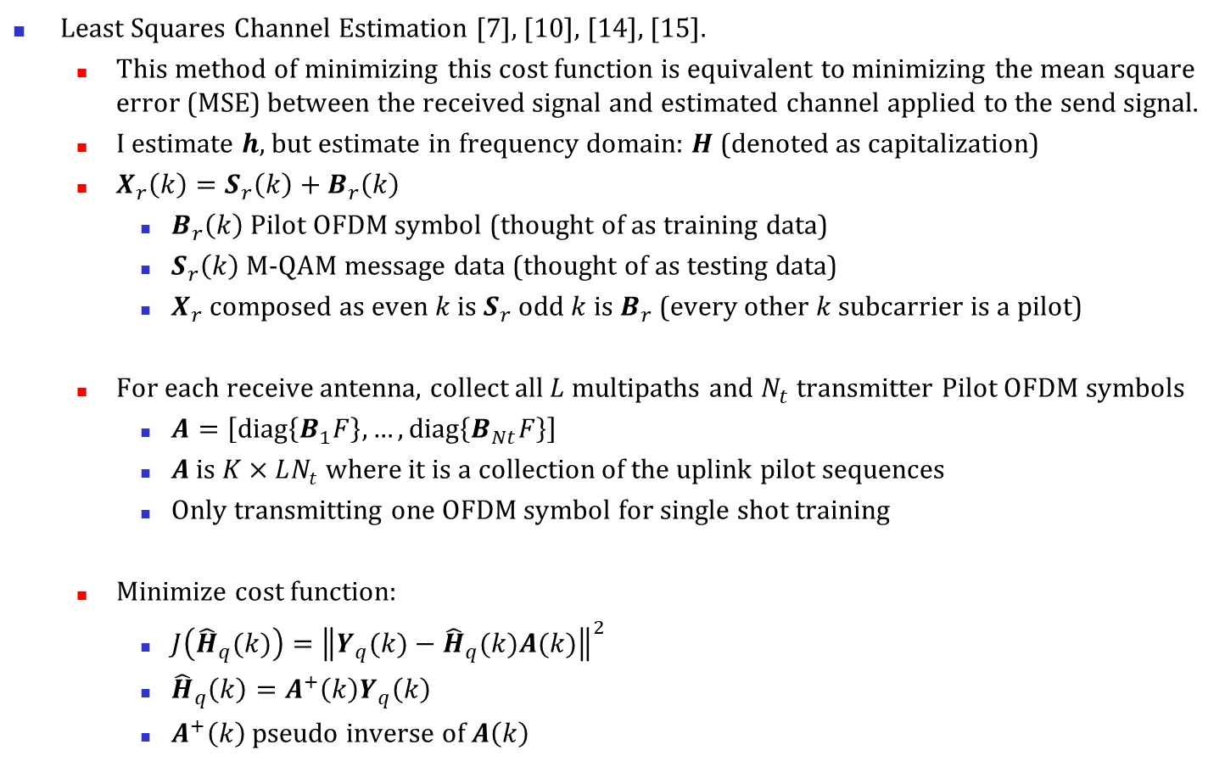
Massive-MIMO-OFDM Channel Estimation
Least Squares Channel Estimation [7], [10], [14], [15].
This method of minimizing this cost function is equivalent to minimizing the mean square error (MSE) between the received signal and estimated channel applied to the send signal.
I estimate $h$, but estimate in frequency domain: $H$ (denoted as capitalization)
$X_{r}\left(k\right)=S_{r}\left(k\right)+B_{r}\left(k\right)$
$B_{r}\left(k\right)$ Pilot OFDM symbol (thought of as training data)
$S_{r}\left(k\right)$ M-QAM message data (thought of as testing data)
$X_{r}$ composed as even $k$ is $S_{r}$ odd $k$ is $B_{r}$ (every other $k$ subcarrier is a pilot)
For each receive antenna, collect all $L$ multipaths and $N_{t}$transmitter Pilot OFDM symbols
$A=\left[\text{diag}\left\{B_{1}F\right\},…,\text{diag}\left\{B_{Nt}F\right\}\right]$
$A$ is $K×LN_{t}$ where it is a collection of the uplink pilot sequences
Only transmitting one OFDM symbol for single shot training
Minimize cost function:
$J\left({\hat{H}}_{q}(k)\right)={\left\|Y_{q}(k)−{\hat{H}}_{q}(k)A(k)\right\|}^{2}$
${\hat{H}}_{q}\left(k\right)=A^{+}\left(k\right)Y_{q}\left(k\right)$
$A^{+}\left(k\right)$ pseudo inverse of $A\left(k\right)$

Slide 11
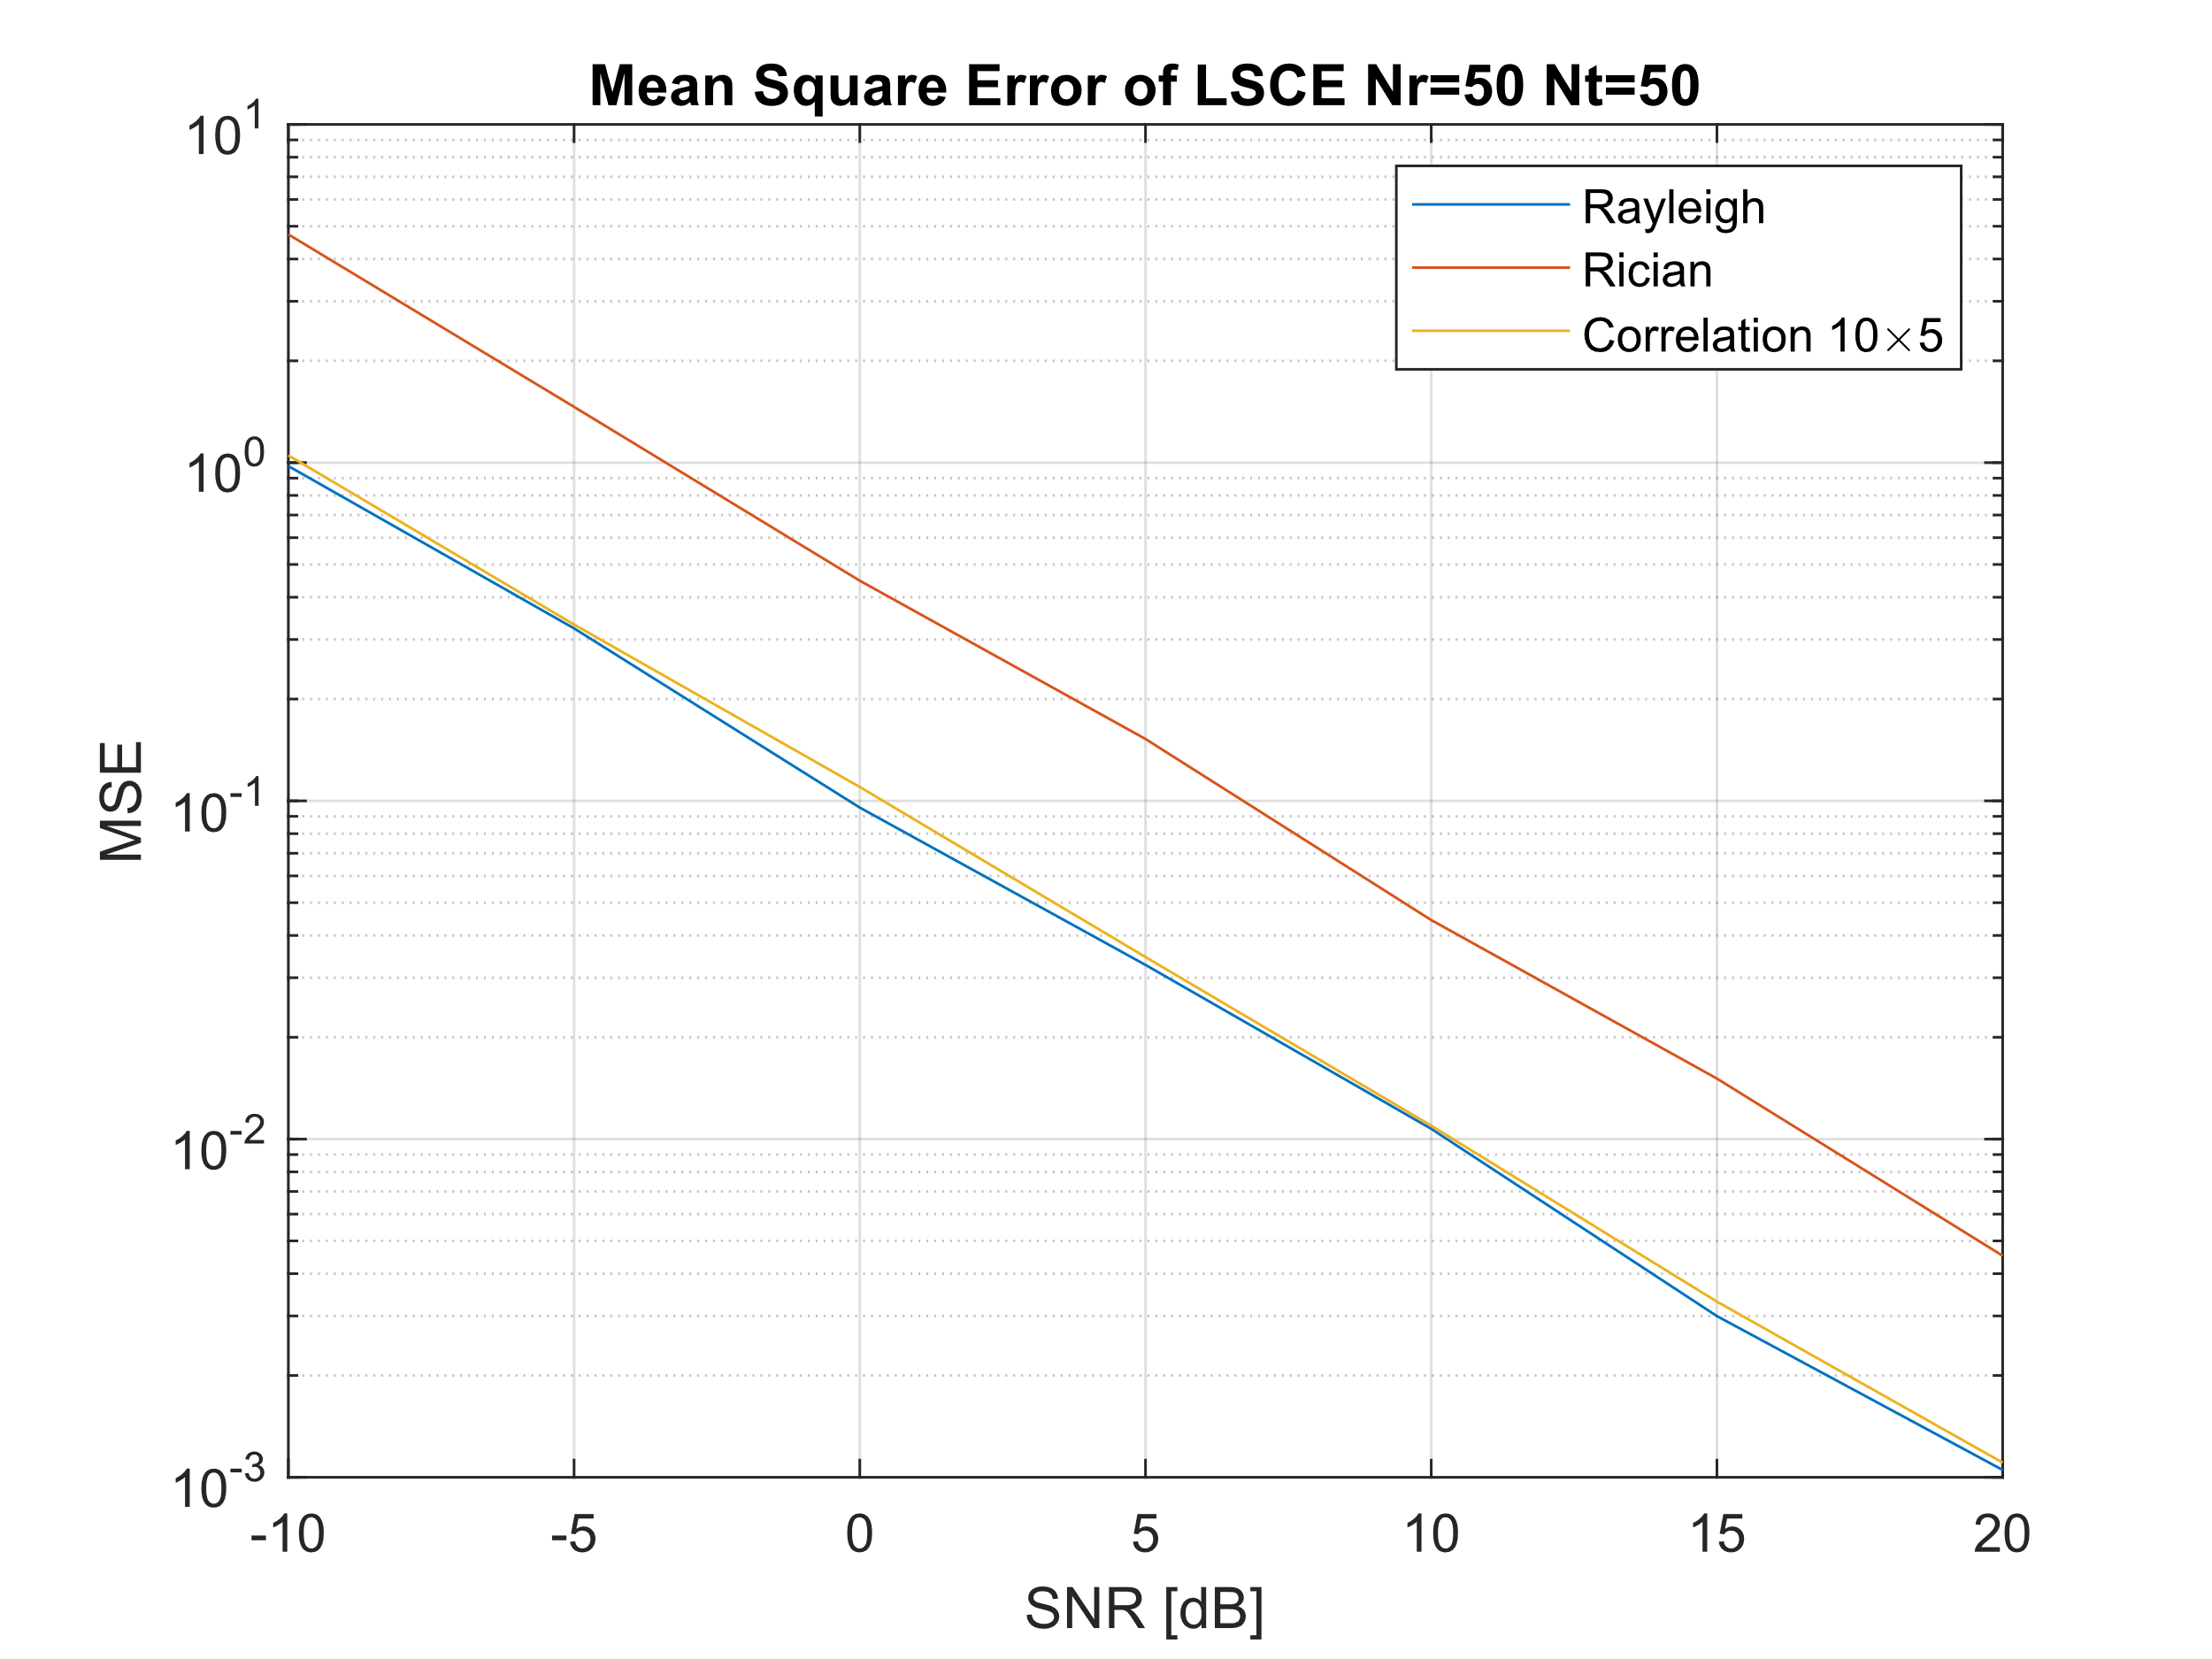
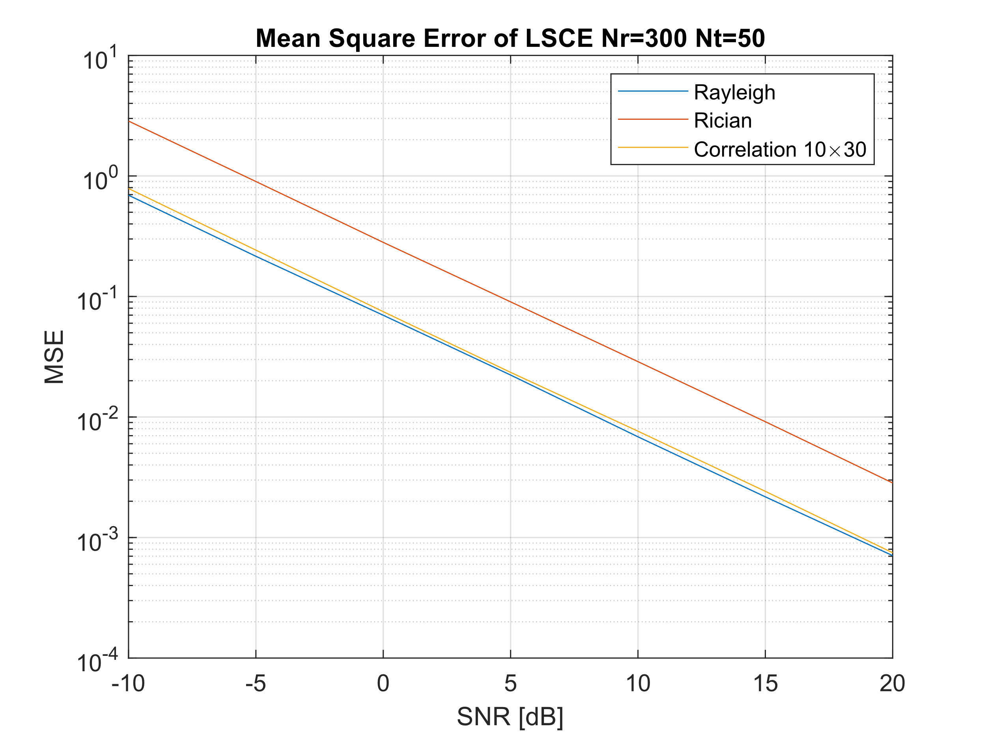
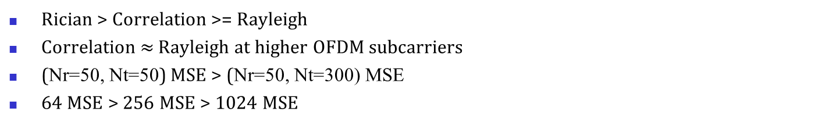
Massive-MIMO-OFDM Channel Estimation
128-QAM with 1024 OFDM subcarriers (Nr=50, Nt=50)
128-QAM with 1024 OFDM subcarriers (Nr=50, Nt=300)
OFDM Subcarriers | M-QAM | Rayleigh | Rician | Correlation (10×5)
64 | 16 | 6.7214 E-2 | 3.1281 E-0 | 2.9421 E-1
64 | 64 | 6.6109 E-2 | 3.1555 E-0 | 3.0126 E-1
64 | 128 | 6.8819 E-2 | 3.5922 E-0 | 2.7155 E-1
256 | 16 | 7.0594 E-2 | 1.5988 E-0 | 1.6424 E-1
256 | 64 | 6.5497 E-2 | 2.1385 E-0 | 1.9336 E-1
256 | 128 | 6.7735 E-2 | 1.8423 E-0 | 1.7594 E-1
1024 | 16 | 3.0952 E-2 | 1.0879 E-1 | 3.2287 E-2
1024 | 64 | 3.1920 E-2 | 1.2351 E-1 | 3.1625 E-2
1024 | 128 | 3.2731 E-2 | 1.5241 E-1 | 3.4534 E-2
OFDM Subcarriers | M-QAM | Rayleigh | Rician | Correlation (10×30)
64 | 16 | 3.6476 E-2 | 3.5693 E-0 | 1.6908 E-1
64 | 64 | 3.5966 E-2 | 3.2485 E-0 | 1.7413 E-1
64 | 128 | 3.6624 E-2 | 3.8035 E-0 | 1.5498 E-1
256 | 16 | 4.1148 E-2 | 2.0428 E-0 | 1.2068 E-1
256 | 64 | 4.0827 E-2 | 2.1208 E-0 | 9.0875 E-2
256 | 128 | 4.0421 E-2 | 1.8677 E-0 | 9.8512 E-2
1024 | 16 | 2.2240 E-2 | 9.1005 E-2 | 2.2708 E-2
1024 | 64 | 2.2208 E-2 | 9.2174 E-2 | 2.1836 E-2
1024 | 128 | 2.2230 E-2 | 9.0250 E-2 | 2.3469 E-2
Rician > Correlation >= Rayleigh
Correlation $≈$ Rayleigh at higher OFDM subcarriers
(Nr=50, Nt=50) MSE > (Nr=50, Nt=300) MSE
64 MSE > 256 MSE > 1024 MSE

Slide 12
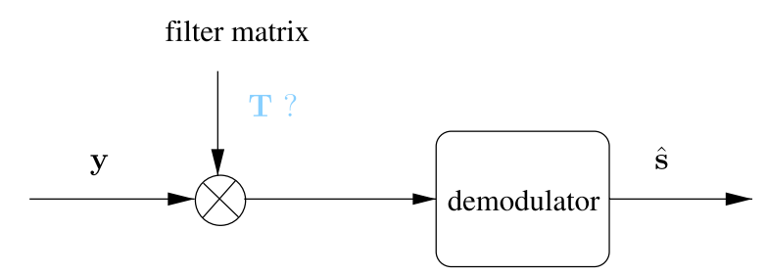
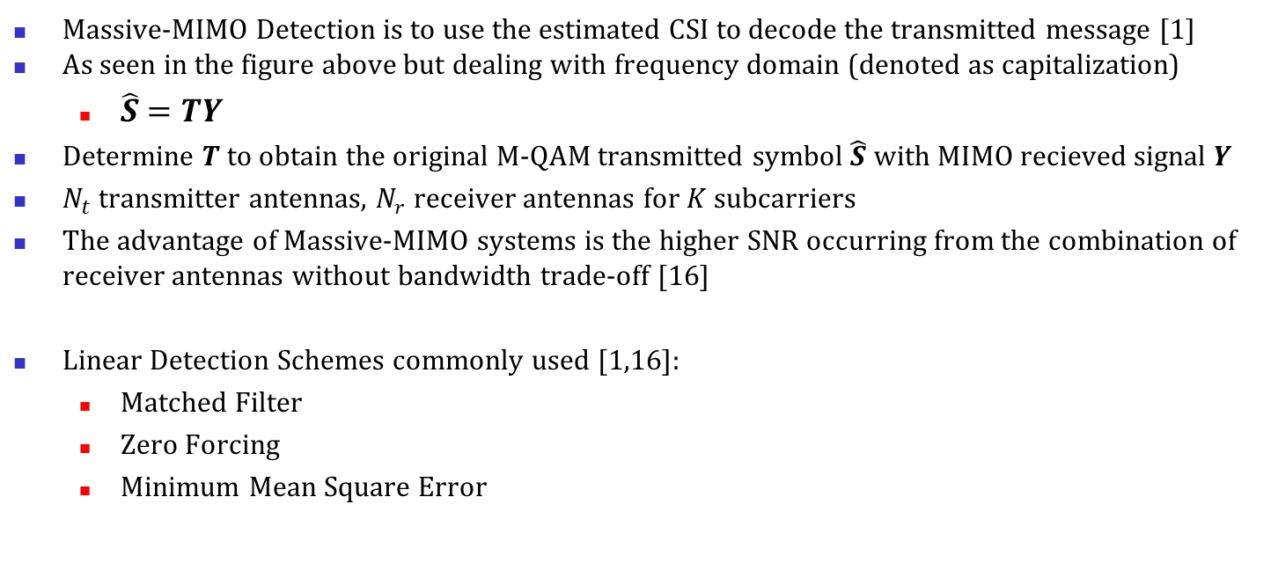
Massive-MIMO Linear Detection
Fig. 19 of S. Yang and L. Hanzo [1]
Massive-MIMO Detection is to use the estimated CSI to decode the transmitted message [1]
As seen in the figure above but dealing with frequency domain (denoted as capitalization)
$\hat{S}=TY$
Determine $T$ to obtain the original M-QAM transmitted symbol $\hat{S}$ with MIMO recieved signal $Y$
$N_{t}$ transmitter antennas, $N_{r}$ receiver antennas for $K$ subcarriers
The advantage of Massive-MIMO systems is the higher SNR occurring from the combination of receiver antennas without bandwidth trade-off [16]
Linear Detection Schemes commonly used [1,16]:
Matched Filter
Zero Forcing
Minimum Mean Square Error

Slide 13
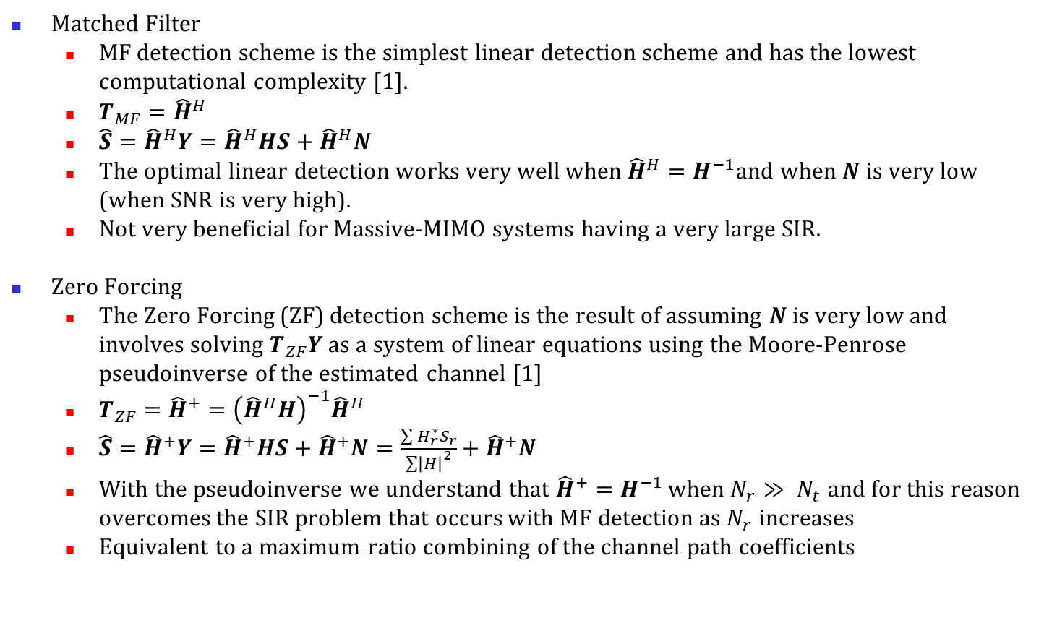
Massive-MIMO Linear Detection
Matched Filter
MF detection scheme is the simplest linear detection scheme and has the lowest computational complexity [1].
$T_{MF}={\hat{H}}^{H}$
$\hat{S}={\hat{H}}^{H}Y={\hat{H}}^{H}HS+{\hat{H}}^{H}N$
The optimal linear detection works very well when ${\hat{H}}^{H}=H^{−1}$and when $N$ is very low (when SNR is very high).
Not very beneficial for Massive-MIMO systems having a very large SIR.
Zero Forcing
The Zero Forcing (ZF) detection scheme is the result of assuming $N$ is very low and involves solving $T_{ZF}Y$ as a system of linear equations using the Moore-Penrose pseudoinverse of the estimated channel [1]
$T_{ZF}={\hat{H}}^{+}={\left({\hat{H}}^{H}H\right)}^{−1}{\hat{H}}^{H}$
$\hat{S}={\hat{H}}^{+}Y={\hat{H}}^{+}HS+{\hat{H}}^{+}N=\frac{\sum{H_{r}^{∗}S_{r}}}{{\sum{\left|H\right|}}^{2}}+{\hat{H}}^{+}N$
With the pseudoinverse we understand that ${\hat{H}}^{+}=H^{−1}$ when $N_{r}≫ N_{t}$ and for this reason overcomes the SIR problem that occurs with MF detection as $N_{r}$ increases
Equivalent to a maximum ratio combining of the channel path coefficients

Slide 14
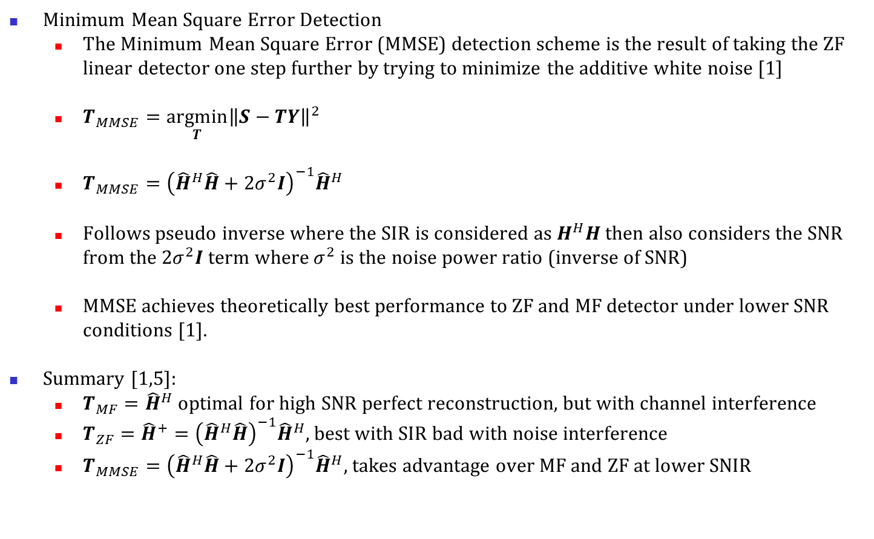
Massive-MIMO Linear Detection
Minimum Mean Square Error Detection
The Minimum Mean Square Error (MMSE) detection scheme is the result of taking the ZF linear detector one step further by trying to minimize the additive white noise [1]
$T_{MMSE}=\underset{T}{argmin}{{\left\|S−TY\right\|}^{2}}$
$T_{MMSE}={\left({\hat{H}}^{H}\hat{H}+2σ^{2}I\right)}^{−1}{\hat{H}}^{H}$
Follows pseudo inverse where the SIR is considered as $H^{H}H$ then also considers the SNR from the $2σ^{2}I$ term where $σ^{2}$ is the noise power ratio (inverse of SNR)
MMSE achieves theoretically best performance to ZF and MF detector under lower SNR conditions [1].
Summary [1,5]:
$T_{MF}={\hat{H}}^{H}$ optimal for high SNR perfect reconstruction, but with channel interference
$T_{ZF}={\hat{H}}^{+}={\left({\hat{H}}^{H}\hat{H}\right)}^{−1}{\hat{H}}^{H}$, best with SIR bad with noise interference
$T_{MMSE}={\left({\hat{H}}^{H}\hat{H}+2σ^{2}I\right)}^{−1}{\hat{H}}^{H}$, takes advantage over MF and ZF at lower SNIR

Slide 15
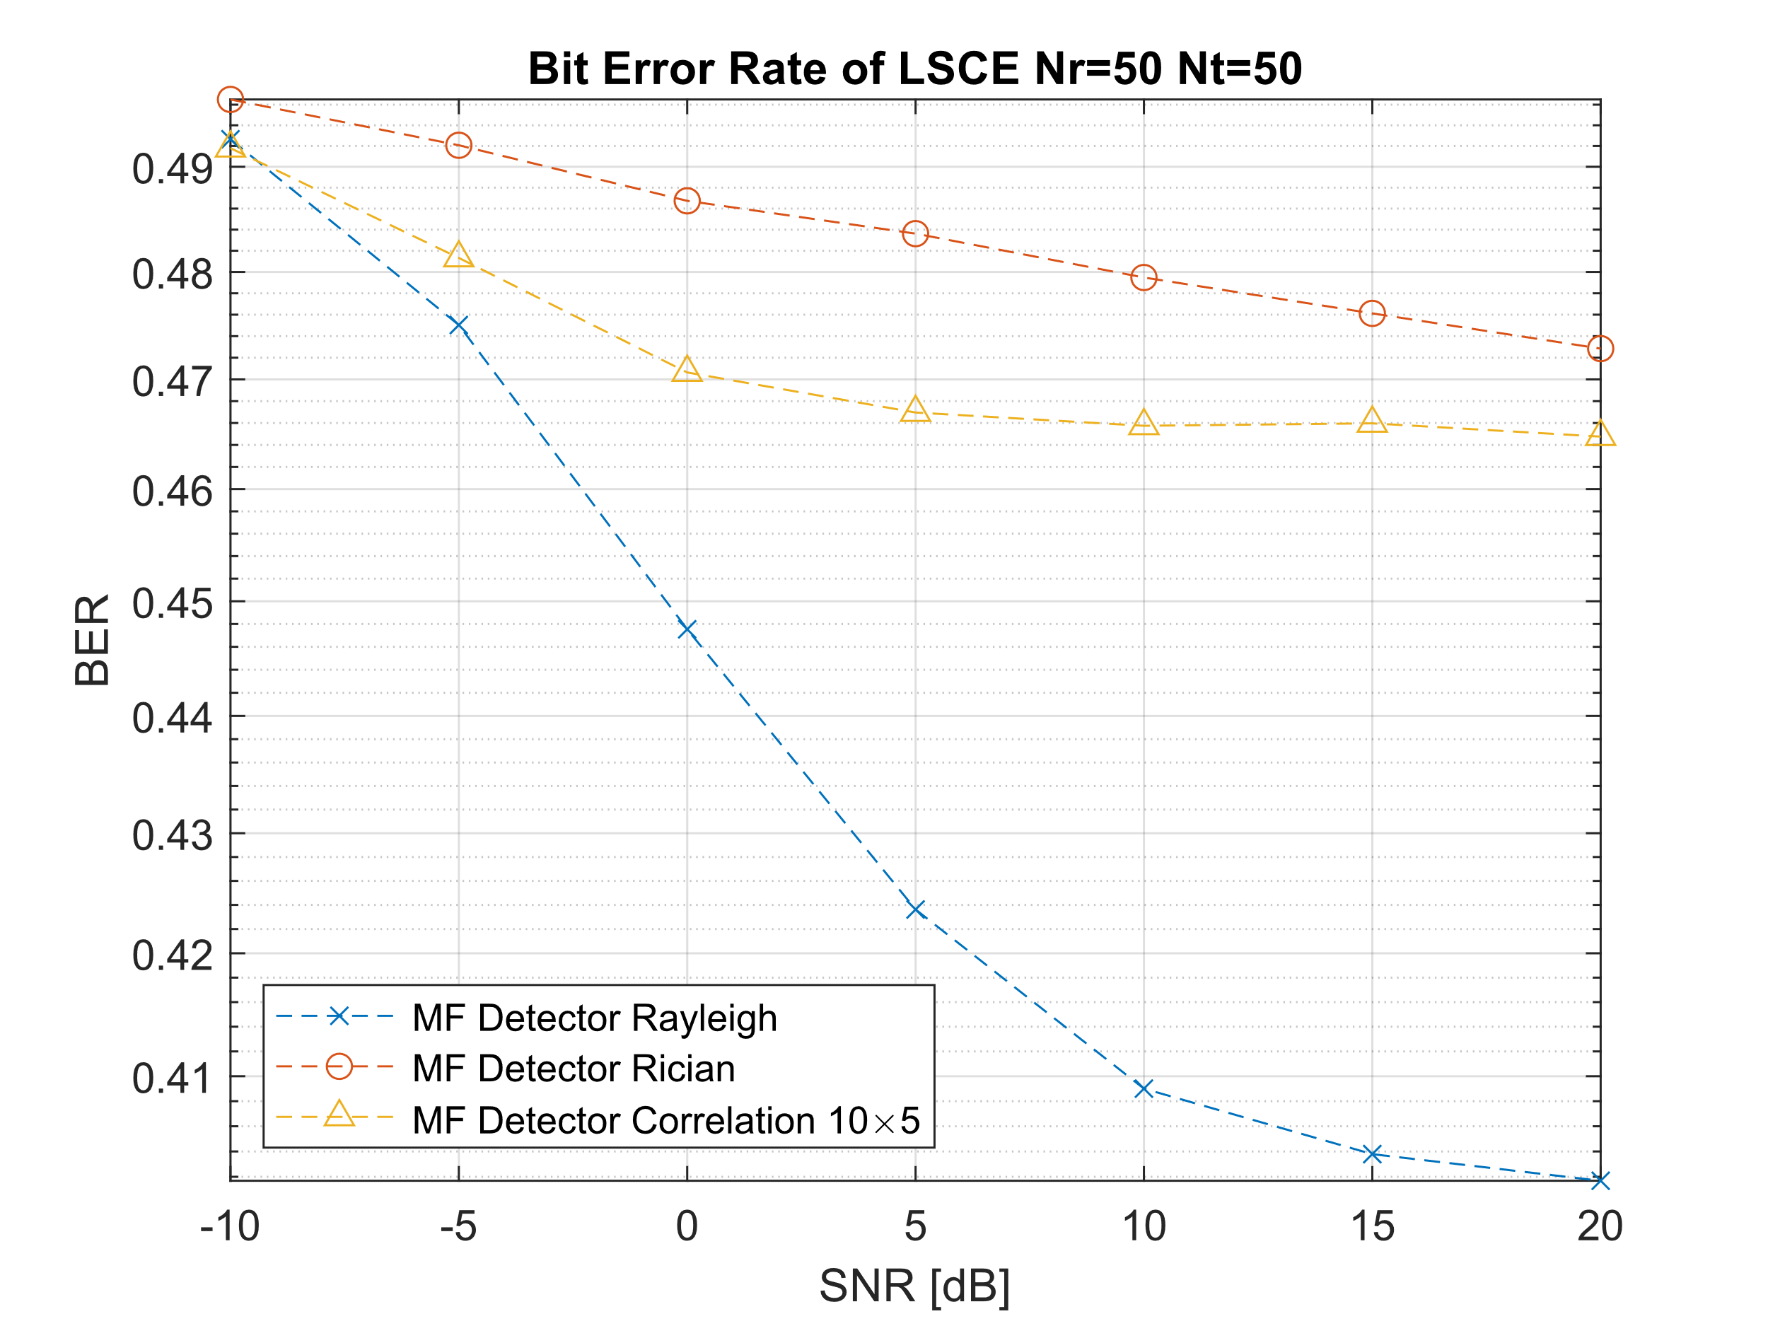
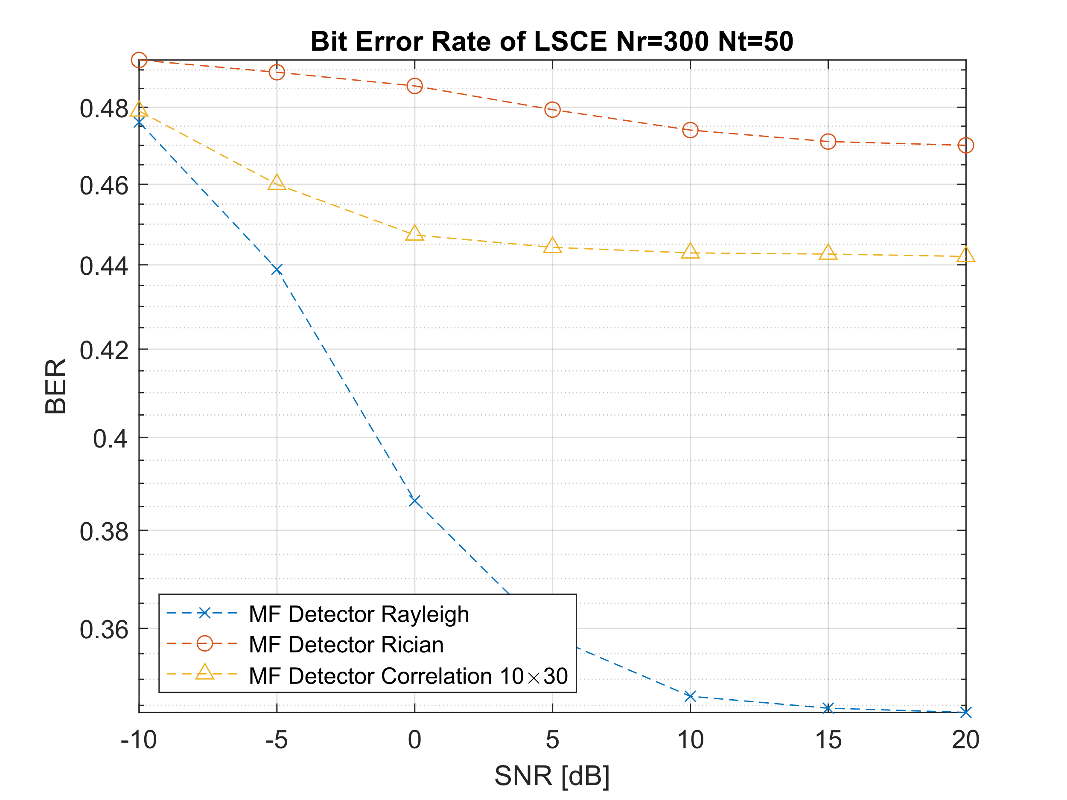
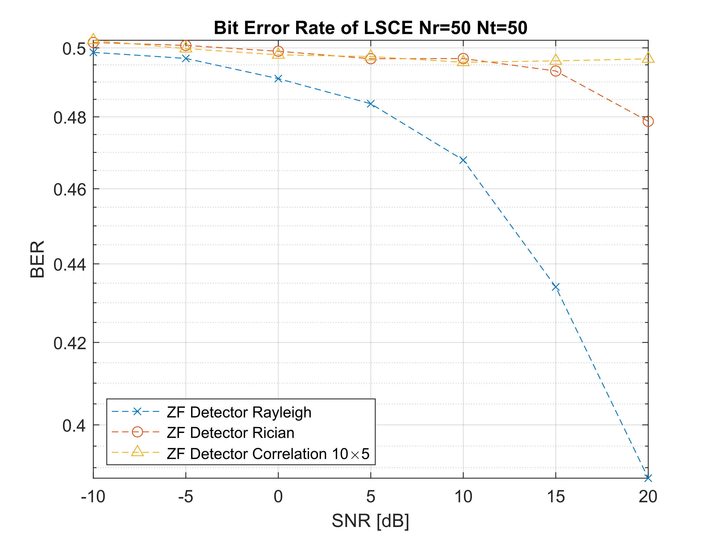
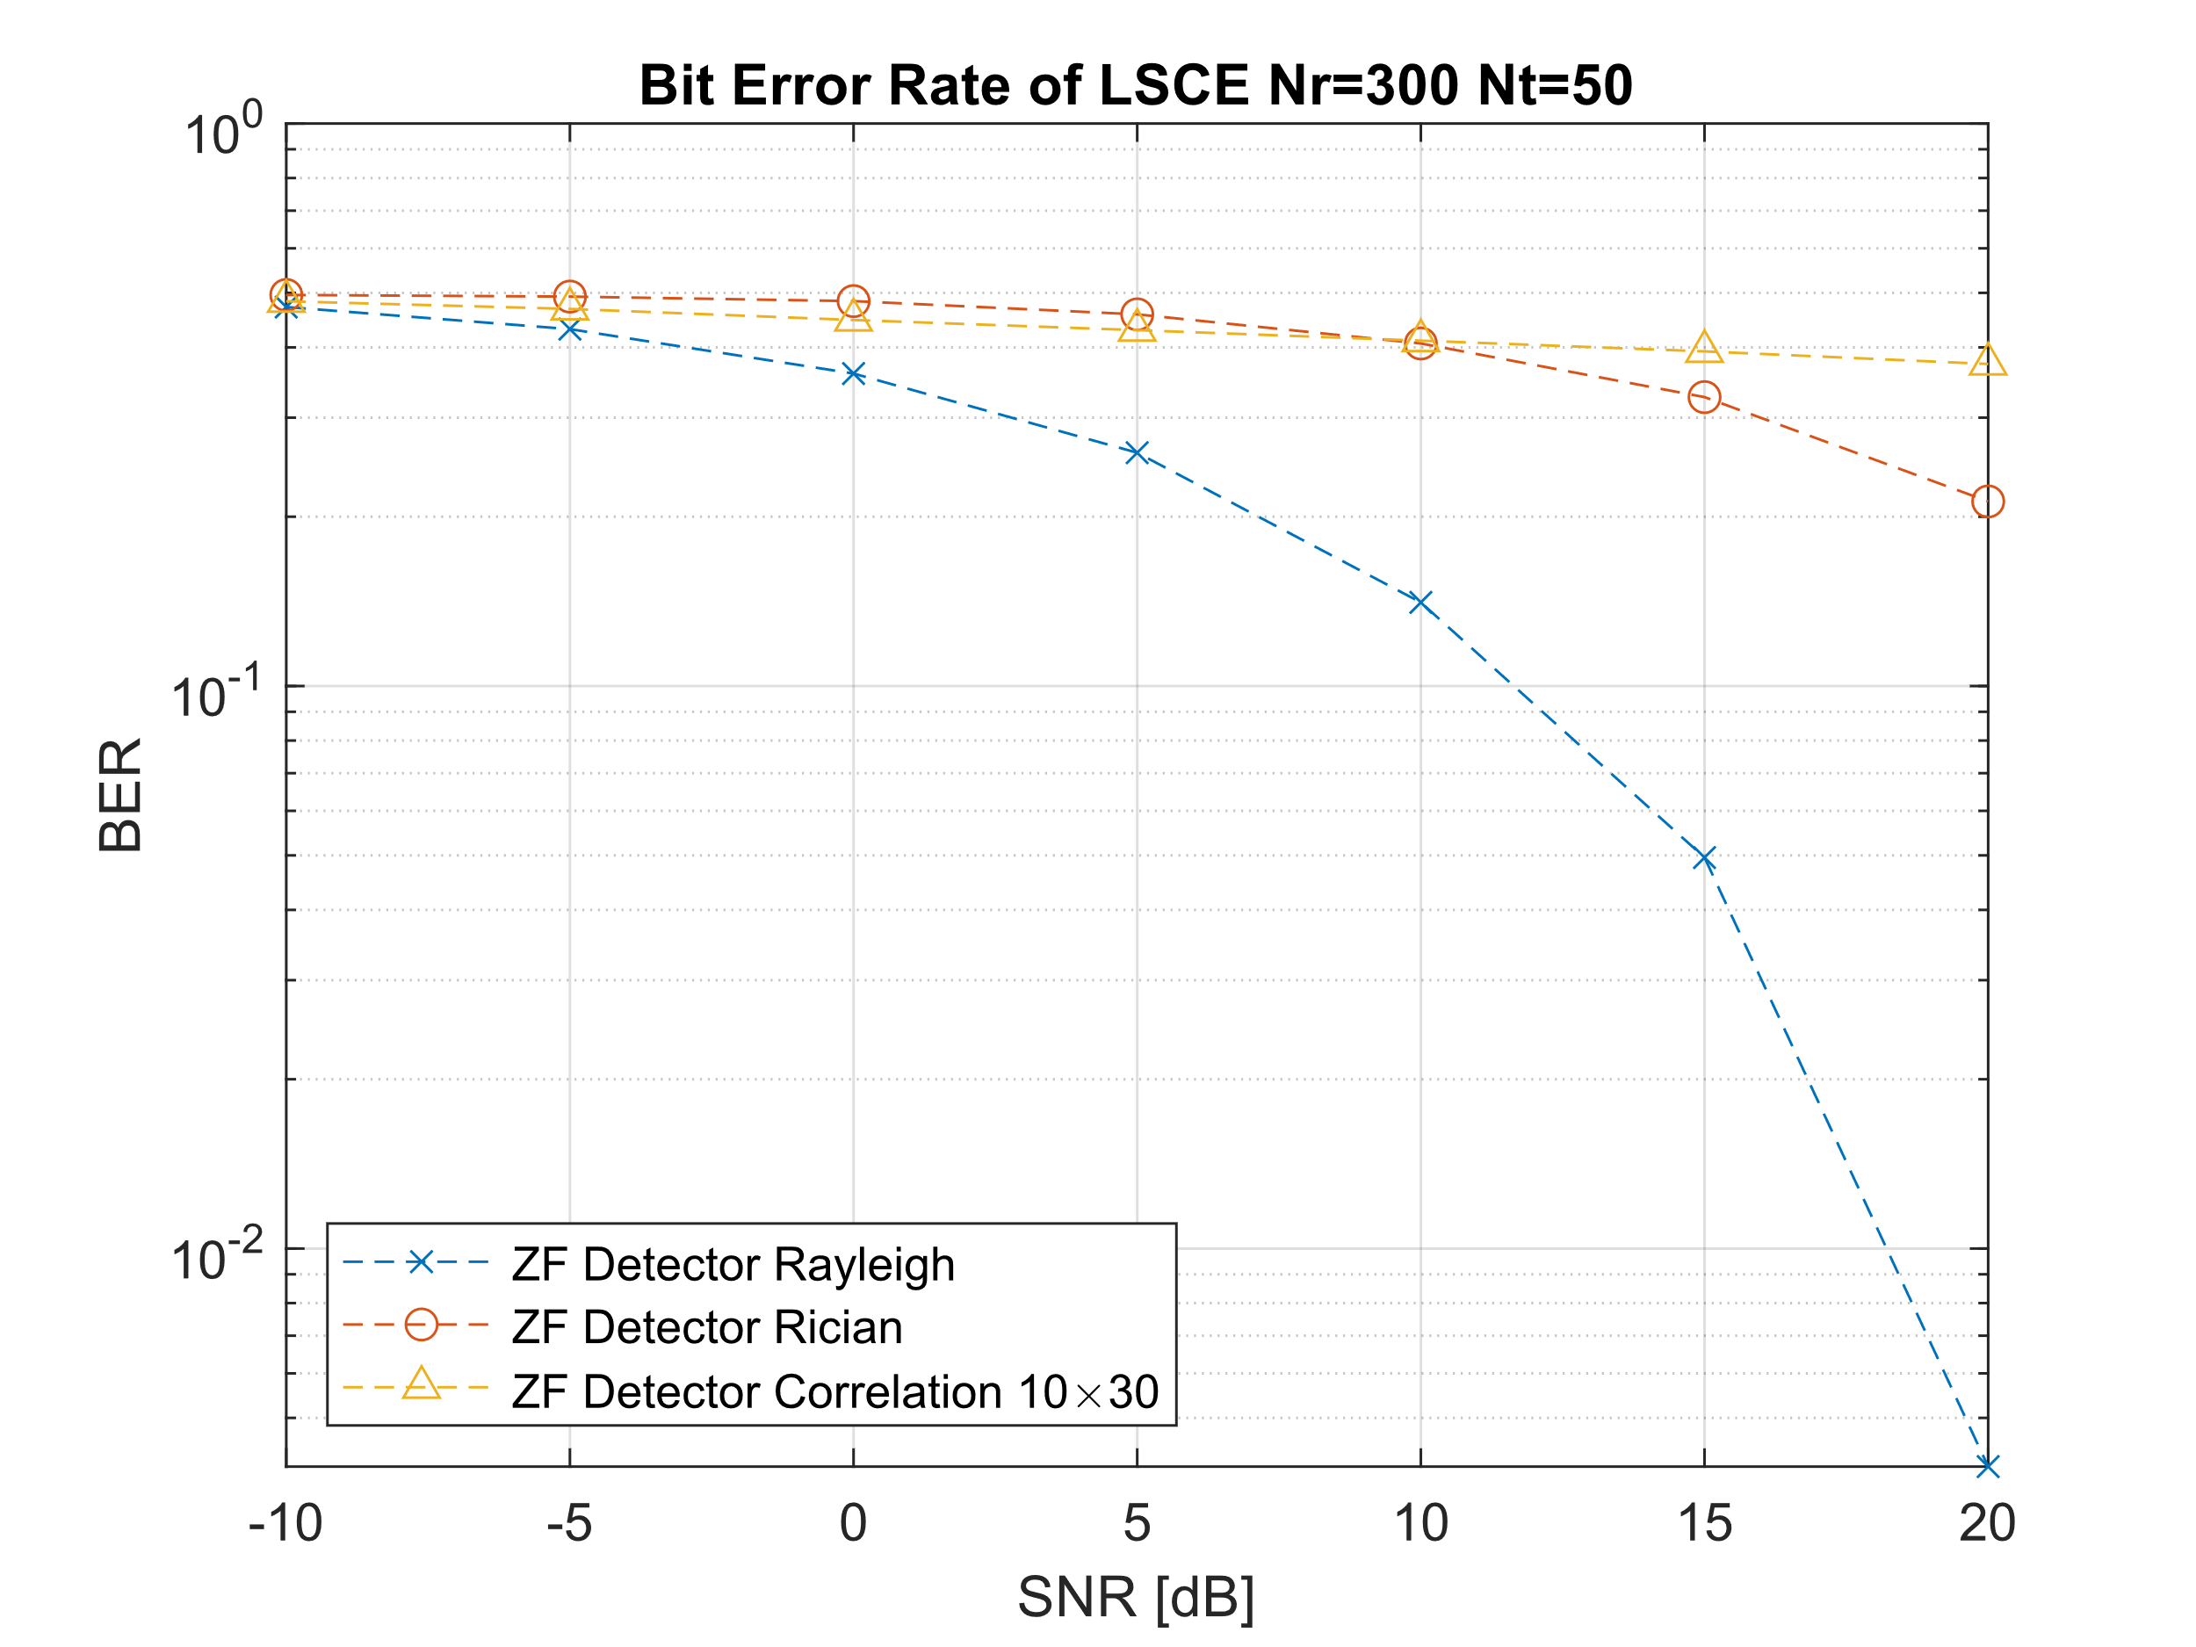
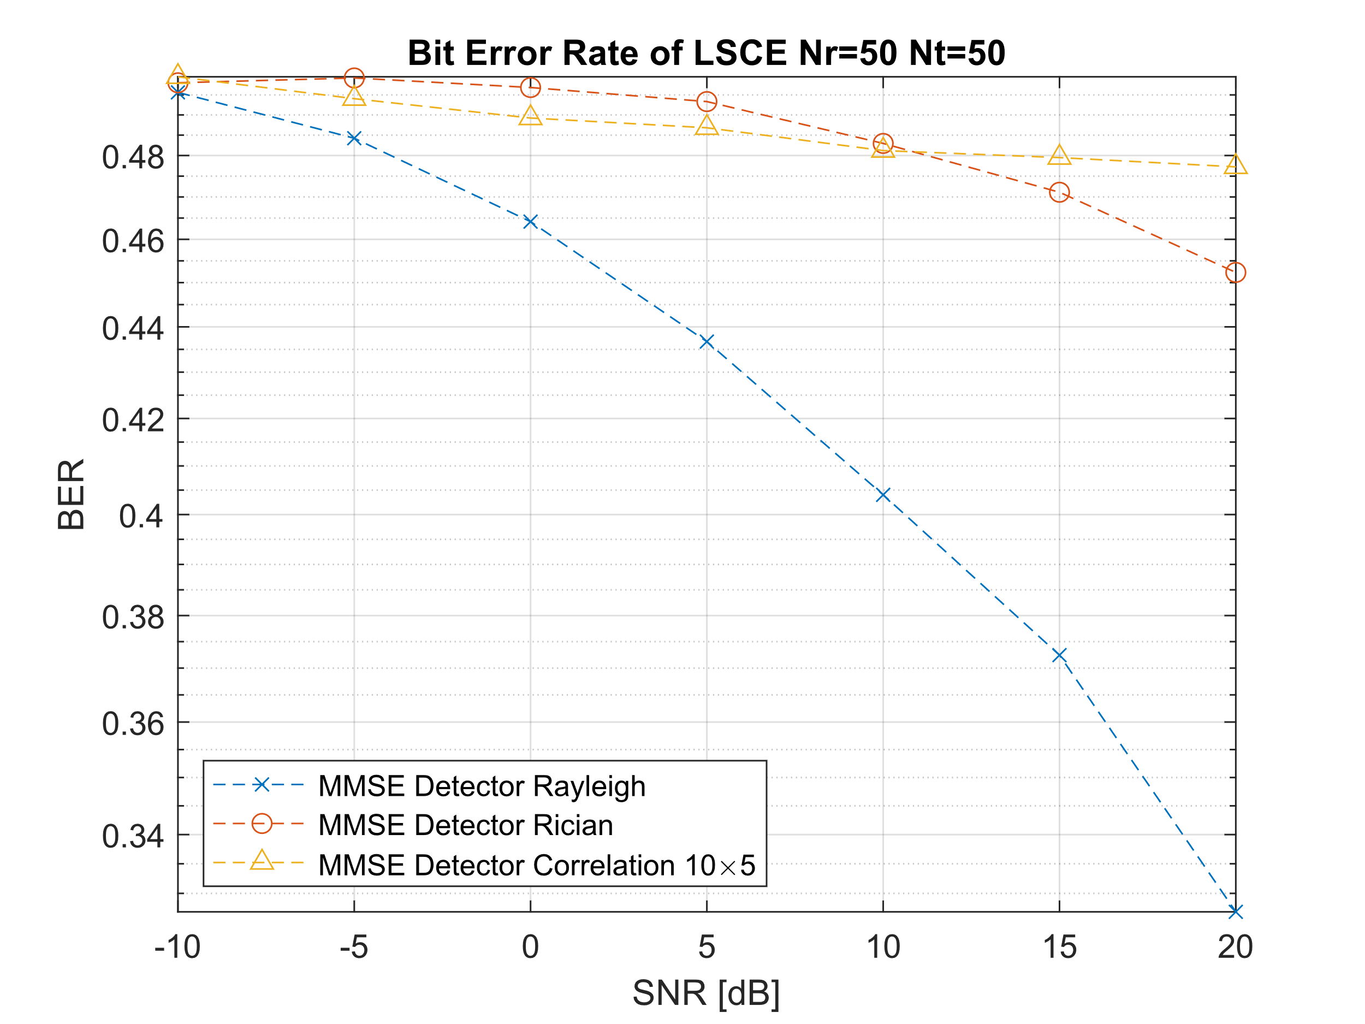
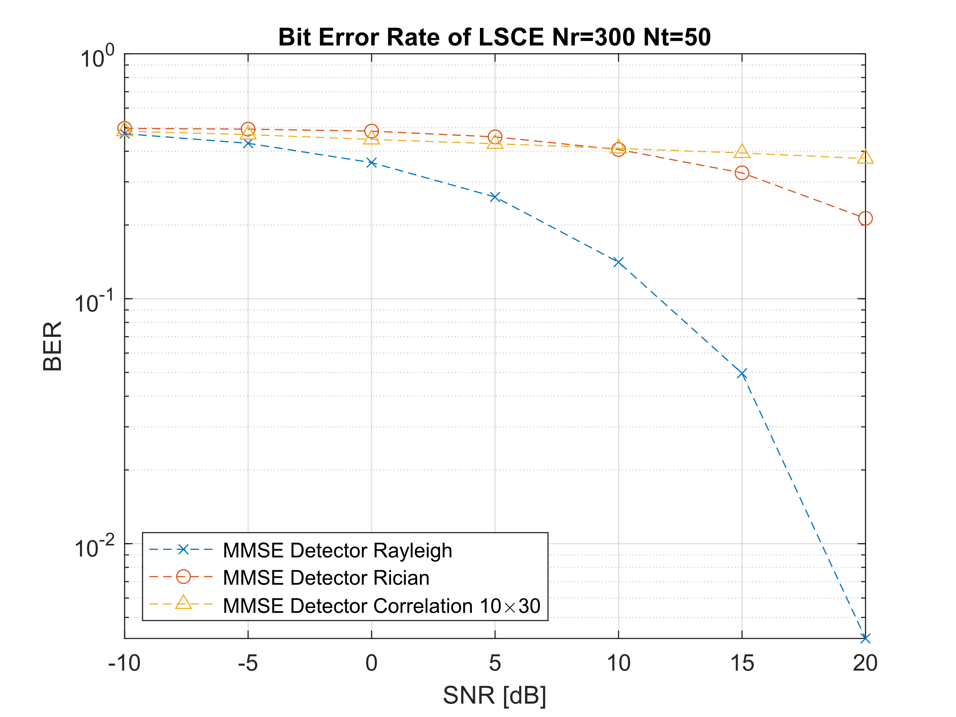
Massive-MIMO Linear Detection
MF Detector
poor performance overall
Suffers with channel interferences
ZF Detector
Good performance
Best at high SNR
At High SNR
Correlation Bad
Rician Okay
Rayleigh Great
Scales with increase in Nr
MMSE Detector
Good performance
Better than ZF at lower SNR
At High SNR
Correlation Bad
Rician Okay
Rayleigh Great
Scales with increase in Nr

Slide 16
Massive-MIMO Linear Detection
BER for 50 Nt to 300 Nr at SNR 5 dB
BER for 50 Nt to 300 Nr at SNR 15 dB
Rayleigh
Rayleigh
OFMD Subcarriers | M-QAM | MF | ZF | MMSE
64 | 16 | 4.3938 E-1 | 5.0641 E-1 | 4.6297 E-1
64 | 64 | 4.6042 E-1 | 5.0208 E-1 | 4.7813 E-1
64 | 128 | 4.6330 E-1 | 4.9696 E-1 | 4.8161 E-1
256 | 16 | 3.6231 E-1 | 3.5184 E-1 | 3.4973 E-1
256 | 64 | 4.1716 E-1 | 4.0641 E-1 | 4.0331 E-1
256 | 128 | 4.1152 E-1 | 4.1634 E-1 | 4.1545 E-1
1024 | 16 | 3.0190 E-1 | 1.1686 E-1 | 1.1702 E-1
1024 | 64 | 3.7115 E-1 | 2.1217 E-1 | 2.1245 E-1
1024 | 128 | 3.5825 E-1 | 2.5990 E-1 | 2.6026 E-1
OFMD Subcarriers | M-QAM | MF | ZF | MMSE
64 | 16 | 4.3281 E-1 | 4.9188 E-1 | 4.8141 E-1
64 | 64 | 4.5677 E-1 | 5.0271 E-1 | 4.8229 E-1
64 | 128 | 4.6438 E-1 | 4.9652 E-1 | 4.9384 E-1
256 | 16 | 3.4852 E-1 | 2.6309 E-1 | 2.6273 E-1
256 | 64 | 4.0828 E-1 | 3.3758 E-1 | 3.3708 E-1
256 | 128 | 4.0027 E-1 | 3.6830 E-1 | 3.6795 E-1
1024 | 16 | 2.8525 E-1 | 7.8125 E-5 | 7.8125 E-5
1024 | 64 | 3.6262 E-1 | 1.7734 E-2 | 1.7773 E-2
1024 | 128 | 3.4447 E-1 | 4.9565 E-2 | 4.9610 E-2
Rician
Rician
OFMD Subcarriers | M-QAM | MF | ZF | MMSE
64 | 16 | 4.9094 E-1 | 5.0188 E-1 | 4.8859 E-1
64 | 64 | 4.9031 E-1 | 5.0740 E-1 | 4.9240 E-1
64 | 128 | 4.9571 E-1 | 5.0920 E-1 | 5.0089 E-1
256 | 16 | 4.7801 E-1 | 4.8059 E-1 | 4.8023 E-1
256 | 64 | 4.9182 E-1 | 4.8635 E-1 | 4.8786 E-1
256 | 128 | 4.8734 E-1 | 4.8741 E-1 | 4.8737 E-1
1024 | 16 | 4.6448 E-1 | 4.2159 E-1 | 4.2157 E-1
1024 | 64 | 4.7560 E-1 | 4.5113 E-1 | 4.5107 E-1
1024 | 128 | 4.7940 E-1 | 4.5793 E-1 | 4.5792 E-1
OFMD Subcarriers | M-QAM | MF | ZF | MMSE
64 | 16 | 4.8953 E-1 | 5.0250 E-1 | 4.7922 E-1
64 | 64 | 4.8969 E-1 | 5.0646 E-1 | 4.8542 E-1
64 | 128 | 4.9670 E-1 | 4.9732 E-1 | 4.9616 E-1
256 | 16 | 4.7266 E-1 | 4.0180 E-1 | 4.0106 E-1
256 | 64 | 4.8646 E-1 | 4.2990 E-1 | 4.2932 E-1
256 | 128 | 4.8036 E-1 | 4.4248 E-1 | 4.4181 E-1
1024 | 16 | 4.5252 E-1 | 1.9593 E-1 | 1.9600 E-1
1024 | 64 | 4.6780 E-1 | 2.8872 E-1 | 2.8879 E-1
1024 | 128 | 4.7100 E-1 | 3.2635 E-1 | 3.2644 E-1
Correlation
Correlation
OFMD Subcarriers | M-QAM | MF | ZF | MMSE
64 | 16 | 4.7813 E-1 | 4.9906 E-1 | 4.8688 E-1
64 | 64 | 4.8604 E-1 | 5.0073 E-1 | 4.9156 E-1
64 | 128 | 4.8884 E-1 | 5.0464 E-1 | 4.8714 E-1
256 | 16 | 4.4082 E-1 | 4.6043 E-1 | 4.5910 E-1
256 | 64 | 4.6563 E-1 | 4.7375 E-1 | 4.7198 E-1
256 | 128 | 4.6080 E-1 | 4.7681 E-1 | 4.7435 E-1
1024 | 16 | 4.1268 E-1 | 3.8016 E-1 | 3.7935 E-1
1024 | 64 | 4.4100 E-1 | 4.2258 E-1 | 4.2216 E-1
1024 | 128 | 4.4437 E-1 | 4.2924 E-1 | 4.2912 E-1
OFMD Subcarriers | M-QAM | MF | ZF | MMSE
64 | 16 | 4.7547 E-1 | 4.9391 E-1 | 4.9594 E-1
64 | 64 | 4.8490 E-1 | 5.0010 E-1 | 5.0438 E-1
64 | 128 | 4.8750 E-1 | 5.0232 E-1 | 4.8670 E-1
256 | 16 | 4.4102 E-1 | 4.5059 E-1 | 4.4879 E-1
256 | 64 | 4.6435 E-1 | 4.6833 E-1 | 4.6758 E-1
256 | 128 | 4.5917 E-1 | 4.7315 E-1 | 4.7214 E-1
1024 | 16 | 4.1001 E-1 | 3.2198 E-1 | 3.2171 E-1
1024 | 64 | 4.3964 E-1 | 3.8128 E-1 | 3.8065 E-1
1024 | 128 | 4.4263 E-1 | 3.9353 E-1 | 3.9355 E-1

Slide 17
Massive-MIMO Linear Detection
BER for 1024 OFDM subcarriers,
128-QAM and 50 Nt at SNR 20 dB
Channel hardening shows only to be effective with Rayleigh Fading Channels
Means Channel hardening does not scale well for LOS components or correlation channels
Rayleigh
BER decreases drastically with increase in Nr
MMSE and ZF greatly outperforms MF
Rician
MF has no BER decrease
ZF and MMSE only small decrease in BER
Correlation
MF has no BER decrease
ZF and MMSE very small decrease in BER
Worst performance at high SNR
ZF and MMSE perform very similarly at 20 dB
Rayleigh
Nr (width × height) | MF | ZF | MMSE
50 (10 × 5) | 4.0169 E-1 | 3.8758 E-1 | 3.2692 E-1
100 (10 × 10) | 3.7667 E-1 | 7.4001 E-2 | 7.4057 E-2
200 (10 × 20) | 3.5537 E-1 | 1.4989 E-2 | 1.4983 E-2
300 (10 × 30) | 3.4367 E-1 | 4.0960 E-3 | 4.1016 E-3
Rician
Nr (width × height) | MF | ZF | MMSE
50 (10 × 5) | 4.7285 E-1 | 4.7874 E-1 | 4.5234 E-1
100 (10 × 10) | 4.5919 E-1 | 3.3164 E-1 | 3.3132 E-1
200 (10 × 20) | 4.6899 E-1 | 2.4936 E-1 | 2.4940 E-1
300 (10 × 30) | 4.7002 E-1 | 2.1295 E-1 | 2.1303 E-1
Correlation
Nr (width × height) | MF | ZF | MMSE
50 (10 × 5) | 4.0169 E-1 | 4.9676 E-1 | 4.7725 E-1
100 (10 × 10) | 4.7093 E-1 | 4.5553 E-1 | 4.5397 E-1
200 (10 × 20) | 4.5018 E-1 | 4.1148 E-1 | 4.1102 E-1
300 (10 × 30) | 4.4205 E-1 | 3.7374 E-1 | 3.7352 E-1

Slide 18
Conclusion
Least square channel estimation was evaluated on an uplink Massive-MIMO-OFDM system comparing MF, ZF and MMSE detection methods on Rayleigh, Rician and Correlation generated channel models.
Massive-MIMO OFDM Channel Estimation and signal detection
Channel hardening clearly effective on Rayleigh i.i.d. fading channels
Bad under conditions
Low bandwidth (low number of OFDM subcarriers)
Correlation channels (given AoA and AoE) or Rician (Line of Sight)
Matched Filter Detection
Best under conditions
50 Nt to 300 Nr, 1024 OFDM subcarriers, ZF or MMSE, Rayleigh Channel (NLOS and no AoA or AoE correlated angles)
Future Work
AoA and AoE estimation because MSE of the LSCE is good so could be possible to apply beam forming from receiver side to overcome problem
Non-linear detection schemes to improve Rician/Correlation channels

Slide 19
References
S. Yang and L. Hanzo, “Fifty years of MIMO detection: The road to large-scale MIMOs,” IEEE Commun. Surv. Tutorials, vol. 17, no. 4, pp. 1941–1988, 2015, doi: 10.1109/COMST.2015.2475242.
J. G. Proakis and M. Salehi, Digital Communications, Fifth Edition. New York, 2008.
H. Q. Ngo and E. G. Larsson, “No Downlink Pilots are Needed in TDD Massive MIMO,” IEEE Trans. Wirel. Commun., vol. 16, no. 5, pp. 2921–2935, Jun. 2016, Accessed: Apr. 08, 2021. [Online]. Available: http://arxiv.org/abs/1606.02348.
E. G. Larsson, O. Edfors, F. Tufvesson, and T. L. Marzetta, “Massive MIMO for next generation wireless systems,” IEEE Commun. Mag., vol. 52, no. 2, pp. 186–195, Feb. 2014, doi: 10.1109/MCOM.2014.6736761.
K. Zheng, S. Ou, and X. Yin, “Massive MIMO channel models: A survey,” International Journal of Antennas and Propagation, vol. 2014. pp. 1–10, 2014, doi: 10.1155/2014/848071.
Y. S. Cho, J. Kim, W. Y. Yang, and C.-G. Kang, MIMO-OFDM Wireless Communications with MATLAB, vol. 1, no. 1. John Wiley & Sons, Ltd, 2010.
A. Riadi, M. Boulouird, and M. M. R. Hassani, “Performance of Massive-MIMO OFDM system with M-QAM Modulation based on LS Channel Estimation,” Proc. Int. Conf. Adv. Syst. Emergent Technol. IC_ASET 2019, no. 1, pp. 74–78, 2019, doi: 10.1109/ASET.2019.8870991.
S. Coleri, M. Ergen, A. Puri, and A. Bahai, “Channel estimation techniques based on pilot arrangement in OFDM systems,” IEEE Trans. Broadcast., vol. 48, no. 3, pp. 223–229, 2002, doi: 10.1109/TBC.2002.804034.
M. K. Arti, “A simple scheme of channel estimation in large MIMO systems,” IEEE Veh. Technol. Conf., vol. 2016-July, pp. 0–4, 2016, doi: 10.1109/VTCSpring.2016.7504106.
A. Riadi, M. Boulouird, and M. M. Hassani, “Least squares channel estimation of an OFDM massive MIMO system for 5G wireless communications,” in Smart Innovation, Systems and Technologies, Dec. 2020, vol. 147, pp. 440–450, doi: 10.1007/978-3-030-21009-0_43.
A. Goldsmith, Wireless Communications. Cambridge university press, 2005.
“3rd Generation Partnership Project; Technical Specification Group Radio Access Network; Multiple Input Multiple Output Antenna Processing for HSDPA.,” TR 25.876 V1.1.0. 3GPP, 2002, Accessed: Apr. 12, 2021. [Online]. Available: https://portal.3gpp.org/desktopmodules/Specifications/SpecificationDetails.aspx?specificationId=1309.
H. Yin, D. Gesbert, M. Filippou, and Y. Liu, “A coordinated approach to channel estimation in large-scale multiple-antenna systems,” IEEE J. Sel. Areas Commun., vol. 31, no. 2, pp. 264–273, 2013, doi: 10.1109/JSAC.2013.130214.
I. Barhumi, G. Leus, and M. Moonen, “Optimal training design for MIMO OFDM systems in mobile wireless channels,” IEEE Trans. Signal Process., vol. 51, no. 6, pp. 1615–1624, 2003, doi: 10.1109/TSP.2003.811243.
M. Cicerone, O. Simeone, and U. Spagnolini, “Channel estimation for MIMO-OFDM systems by modal analysis/filtering,” IEEE Trans. Commun., vol. 54, no. 11, pp. 2062–2074, 2006, doi: 10.1109/TCOMM.2006.884849.
B. Trotobas, A. Nafkha, and Y. Louët, “A Review to Massive MIMO Detection Algorithms: Theory and Implementation,” in Advanced Radio Frequency Antennas for Modern Communication and Medical Systems, IntechOpen, 2020.

